Slide 1
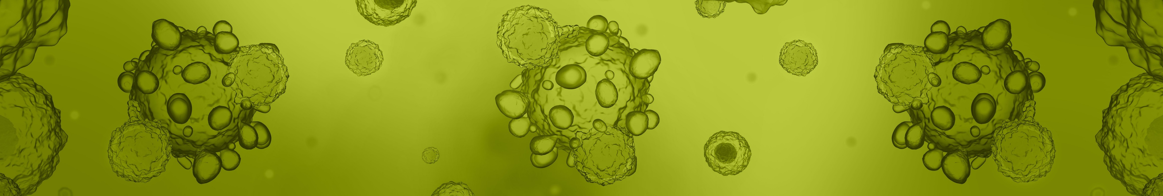

The evolving requirements of allogeneic starting materials
Dr Roger Horton, SCUG June 2022

Slide 2
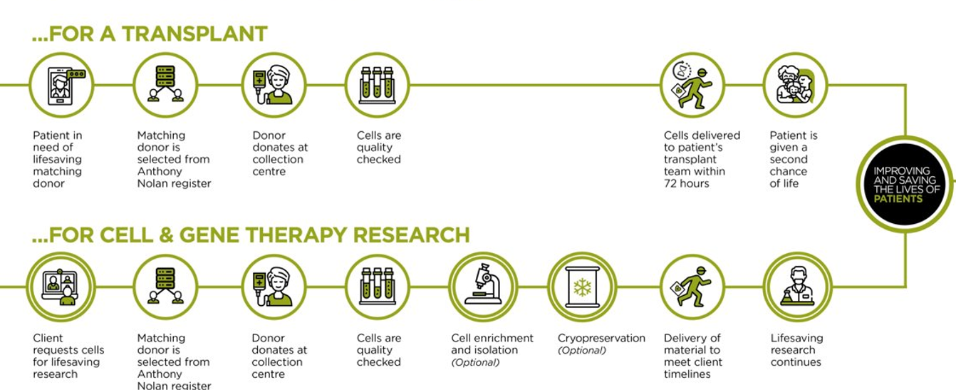
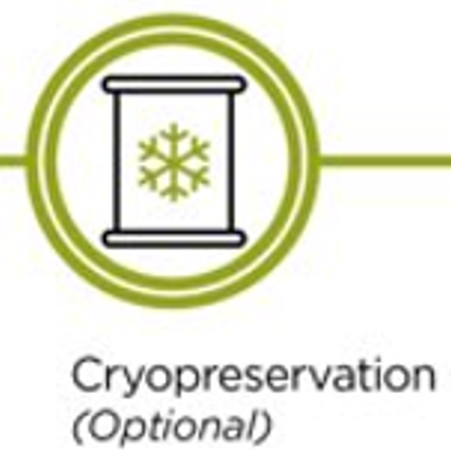
The Journey of the cell….
& ATMP MANUFACTURE
Lifesaving research continues or ATMP manufactured

Slide 3

The changing landscape
ATMPS in development
3000
*
Cell Therapy Developers
Historically harvested cells were used for transplant
However as more ATMP’s are developed this is likely to change, and soon!
By 2025 over 800 adoptive therapy clinical trials would have been completed
400
Therapies Expected to be submitted for approval by 2022
30
Therapies that have been approved and are available for patients therapies
3

Slide 4
The changing landscape
As a result changes need to be made in our approach to licencing, consent, IDM testing, collection, processing, release testing, signoff and transportation of allogeneic cell donations
These changes need to be made in order to facilitate increased numbers of clinical trials and routine production of therapeutic products
Apheresis in particular will be in very high demand

Slide 5
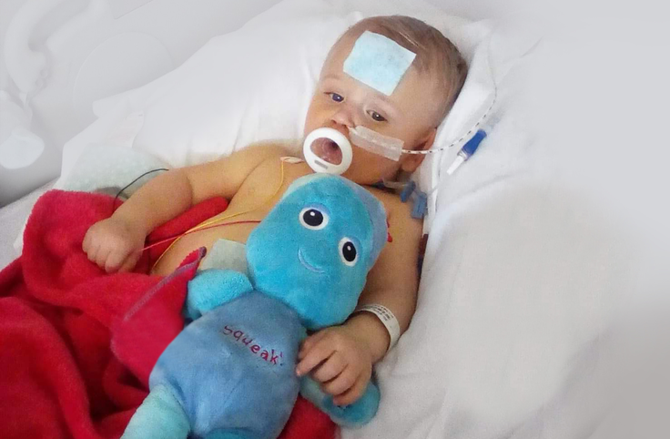
Ramifications…
The only thing worse than not having a treatment, is having a treatment you cannot access.

Slide 6
Requirements - Licencing
In order to facilitate the provision of starting materials the ATMP category needs to be added to the relevant areas of your HTA licence e.g.
Collection – cell type (ATMP)
Processing – cell type (ATMP)
Storage – cell type (ATMP)
Particular product types will also need to be added and validated (PPD) e.g. lymphocytes for transplant are referred to as DLI, whereas these same cells used as ATMP starting material are described as PBMNC (ATMP) so the usage dictates the tissue type

Slide 7
Requirements - Consent
The consent process will need broader language in order to cover potential additional uses as it could be for a clinical trial or ATMP manufacture by Pharma in addition to transplant
This needs to be clearly outlined to the donor in advance of harvest in line with HTA requirements to ensure they fully understand the possible uses of their cells
A separate consent form can be developed for starting materials if you prefer this option over broad consent

Slide 8
Requirements - Virology
The timing required for testing changes for ATMP starting material; whereas cells for transplant can be tested up to 30 days before infusion. Day of donation testing is required for starting materials under HTA regs as there is no “urgent need”
The testing requested may also be different from the standard panel required under HTA depending upon the end users requirements and geographic location
E.g. for certain tissue of placental origin, Chlamydia screening is a requirement in Germany. In other countries CMV NAT is required on blood products used as starting materials
Finding CE marked tests for everything can be challenging!

Slide 9
Requirements - Collection
Collection parameters need to be monitored depending upon whether or not there are plans to cryopreserve downstream
Retrospective data gathered during AN cryo’s suggest that HCT, NC/ml and age at cryopreservation can have significant effects on CD3 and CD34 viability
Ideally HCT <4%, NC/ml < 200 x 10⁶/ml, age at freezing <36 hours
These may be significant factors if a collection is performed to provide starting material for a CAR-T product for example
Other therapies may have specific collection parameters as required by the manufacturers

Slide 10
Requirements - Processing
Processing parameters may be different depending upon the end use, e.g. cell density, DMSO concentration, additional additives
This would require a PPD for each new starting material process
We propose the creation of a SCUG validation group – harmonised PPD’s across multiple centres would save time for both ourselves and the HTA otherwise everyone will be reinventing the wheel
If this were acceptable to the regulator then new processes could be rapidly adopted by demonstrating compliance with an existing PPD’s end point criteria

Slide 11
Requirements – Release testing
Transplant release testing has well established parameters such as CD34/CD45 viabilities and recoveries, potency and sterility etc
However release testing for ATMP starting materials may be entirely different depending upon the cells
As such new assays may need to be validated and tested, bringing us back to the previous point around PPD’s
In order to find relevant end points we will need to work with the manufacturer’s to ascertain “what good looks like”

Slide 12
Requirements – Transportation
This will depend heavily on the manufacturer’s requirements and there are range of common options:
2-8C
Controlled ambient
< -175C
Logistics for these options need organising and relevant agreements need to be in place
A specialist logistics provider would be best for international shipments due to the complex nature of customs and the fragility/value of the product being shipped

Slide 13
So what now?
Streamlining adoption of new processes and being aware of new requirements in a range of areas will be critical for the rapid growth needed to provide materials for ATMP manufacture
Increasing capacity is also essential as the number of therapies emerging is enormous and we will not be able to deliver these to patients if we cannot scale our activities
Donors seem to be overwhelmingly in support of providing materials for such therapies and patients will need these new treatments, so lets make it happen!

Slide 14

Any Questions?

