Slide 1
Urgent Need to Validate a Replacement Method for Clinical CD34+ cell Purification
Mike Watts UCLH

Slide 2
COBE 2991 and CliniMACS I discontinuation 2023
CliniMACS II supported to at least 2033 but if depending on either machine a new method must be validated. This could be;
CliniMACS II with an alternative clinical scale cell washer OR
Miltenyi Prodigy (fully automated CD34 enrichment processing)
Sufficient HPC for validation work is problematic. An optimised thaw method could allow discard cryopreserved HPC harvests to be used for this purpose.

Slide 3
COBE 2991 and CliniMACS CD34 Selection Steps
COBE 2991
Run harvest into wash bag (600ml capacity) 5min
Wash x1 1000 rpm (platelet wash) 10min
Remove supernatent and leave 100ml product for CD34 bead incubation
Add CD34 reagent & incubate with agitation 30 min
Wash 1000 rpm 10min x 2 25 min
CliniMACS column run* 40 min
Total processing time 110 min
*CD34 bead stained cells captured on magnetic column, rinsed with PBS buffer
Magnet removed, CD34 cells recaptured and washed x2
Magnet removed, CD34 cells dispensed into target capture bag
Additional wash to replace PBS with saline for infusion recommended (not required if diluent pharma approved)

Slide 4
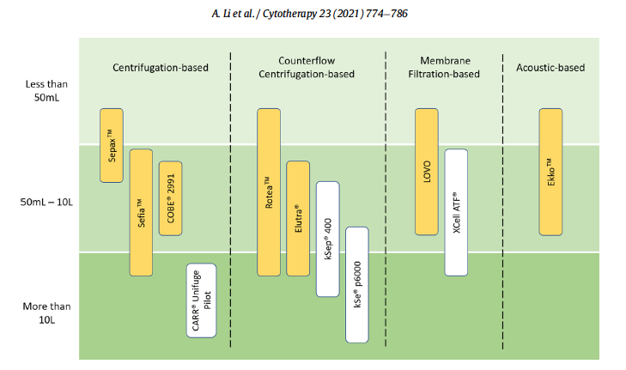
Clinical Scale Cell Processors (review)

Slide 5
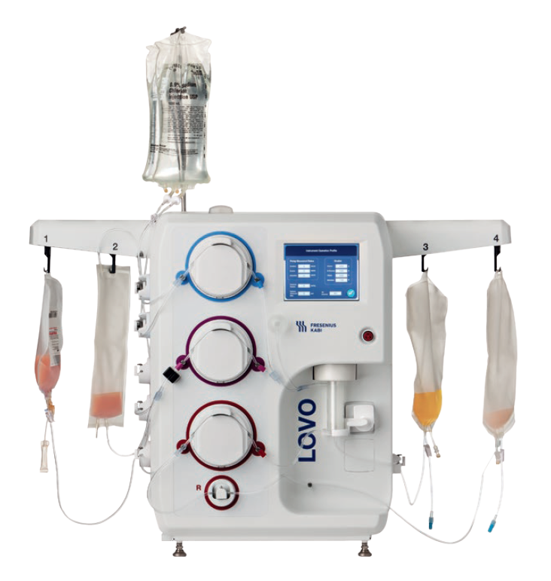
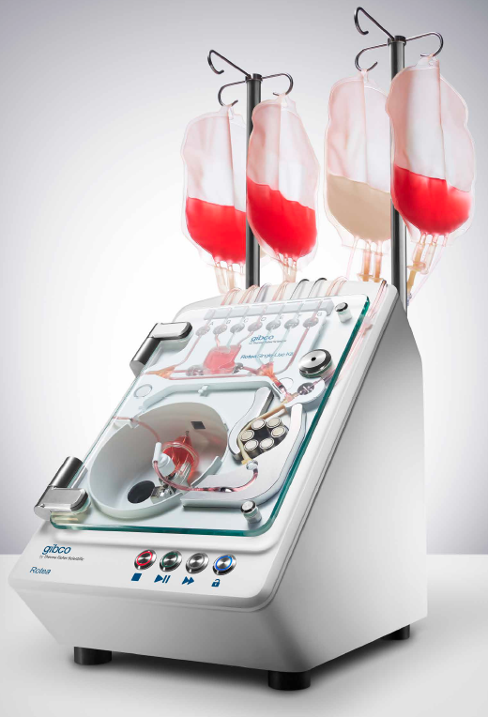
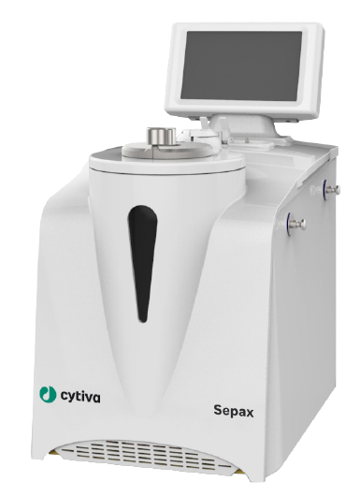
Clinical Scale Cell Processors and Thaw HPC
1. ‘Blood bank’ centrifuge and bag press
2. Lovo (Fresenius Kabi)
Mfarrej et al Cytotherapy, 2017; 19: 1501–1508
DMSO removal from thaw HPC
3. Rotea (Gibco)
Elutriation chamber
Li et al Cytotherapy 24 (2022) 650-658
Ahmed et al ISCT 2005 monocytes from thaw HPC
4. Sepax (Biosafe)
Spinning syringe on density gradient (eg Ficoll)
Aerts-Kaya et al BMT (2018) 53:1225–1227
DMSO removal from thaw HPC

Slide 6
Improved Thaw HPC Evaluation
Aim – To minimise thaw cell losses due to lysis, clumping, reduced viability and stability
Wider benefits for laboratory testing/processing of many cryopreserved cell samples
Variables : Diluent choice, addition method, temperature and stability over time and centrifugation/wash steps
HPC test material for validation work?
  Fresh samples allow pre-freeze WBC, viability, CD34, CD45, (CFU if possible). Eg non-target CliniMACS ‘waste fraction’ ideal for bulk testing. Excess HPC from donor DLI fractions or from QC testing?
  Discard HPC-A or CORD clinical products (potential for thaw, split and refreeze?)
Work up
  Pre-clinical : Promising thaw protocols initially evaluated with white counts, TB, flow viable CD34. miniMACS to ensure CD34 selection not compromised.
  Clinical scale CliniMACS vs New cell washer or Prodigy CD34 enrichment.

Slide 7
4% HSA in PBS at 4⁰C for CD34 selection of HPC
Bohbot et al BMT 1996 17, 259-264
Pre-clinical, lab assessment for CellPro CD34 selection from cryopreserved HPC prior to clinical scale use (n=5)
Over 40 thaw samples divided and washed x1 with PBS or 4% HSA in PBS resulted in over 30 versus 5 samples with visible cell clumps. 4% HSA alone insufficient unless used at 4⁰C*
*Higher HSA at 4⁰C adopted from French pre-infusion thaw HPC DMSO wash protocols, eg
Beaujean 1991 BMT 8:291-294 (COBE 2991)
Calmels 2003 BMT 31:823-828 (Cytomate)
Lemarie 2005 TRANSFUSION 45:237-742 (Cytomate)

Slide 8
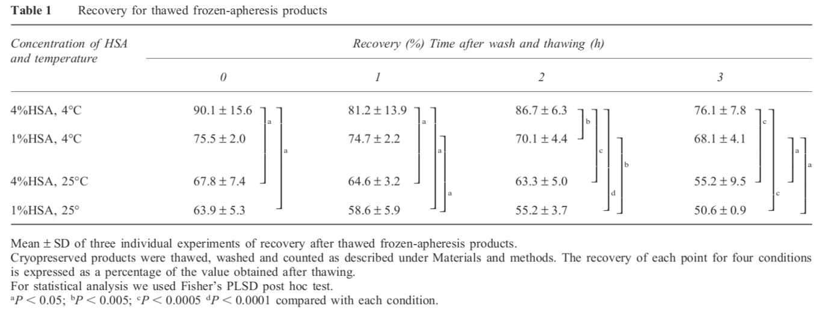
4% HSA in PBS at 4⁰C for HPC CD34 enrichment
Koizumi et al BMT 2000 26, 787-793
Pre clinical lab studies of thaw clumping using WBC yields
Cryopreserved products thawed, divided and washed twice in either 4% HSA at 4⁰C or 1% HSA at 4⁰C, 4% HSA at 25⁰C or 1% HSA at 25⁰C. White cell counts performed immediately after the second wash (T0) and stability checked after T+1hr, T+2hr and T+3hrs of incubation.
After full 3hrs, 4% HSA at 4⁰C gave superior yields to starting time of any other other condition selected

Slide 9
Plasma-Lyte A
‘Plasmalytes’
Pharmaceutically approved for infusion
Validated extensively in blood transfusion practice to maintain cell products such as platelet suspensions at room temperature for several days
Plasmalyte A with 4% HAS proposed as a replacement for Dextran 40 to improved thaw cord blood infusion.
Plasma-Lyte (Baxter) https://www.drugs.com/pro/plasma-lyte-a.html
Plasma-Lyte A pH 7.4 (Multiple Electrolytes Injection, Type 1, USP) sterile, nonpyrogenic isotonic solution for intravenous infusion.
Each 100 mL contains 526 mg of Sodium Chloride, USP (NaCl)
502 mg of Sodium Gluconate (C6H11NaO7)
368 mg of Sodium Acetate Trihydrate, USP (C2H3NaO2•3H2O)
37 mg of Potassium Chloride, USP (KCl)
30 mg of Magnesium Chloride, USP (MgCl2•6H2O).
pH is adjusted with sodium hydroxide. The pH is 7.4 (6.5 to 8.0)
Osmolarity = 294 mOsmol/L (Normal physiologic osmolarity range is 280 to 310 mOsmol/L)
(Composol from Fresenius for platelet use, very similar formulation but adds sodium citrate)
NB: Thaw diluent must not contain calcium (clot risk for ACD anti-coagulant products

Slide 10
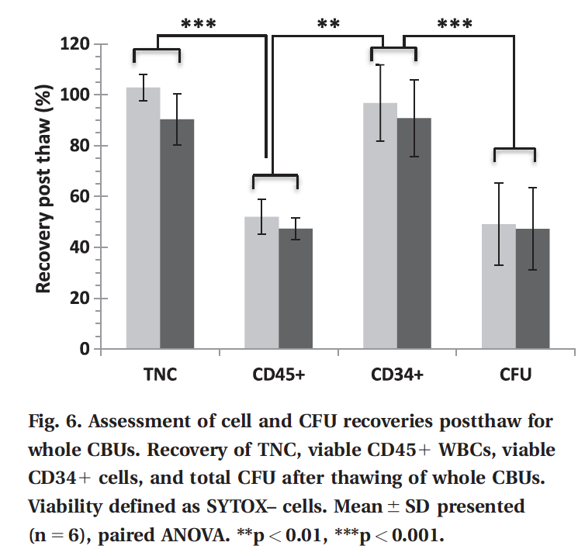
Plasma-Lyte A Thaw and Dilute Protocol for Cord Blood
Pasha et al TRANSFUSION 2017 57, 1744-1754
CBU thaw solutions Plasma-Lyte 4%HSA vs.
Dextran 40 in saline and 4%HSA
Target : Viable CD45 & CD34 yields >40% & >70% up to 4hrs after thaw. (NetCord-FACT standard)
Divided CBU into test vials used to compare viable CD45, CD34 and CFU yields for various thaw protocols
Diluent volume:cell ratio varied from 1:1 to 1:6
RT vs. 4⁰C compared
Progressive vs. direct dilution compared
Stability tested over 4 hrs
In all experiments Plasma-Lyte yields were superior to Dextran
After thaw at 37⁰C, thaw solution at RT superior to 4⁰C
No significant difference in viable CD34 recovery with higher dilutions than 1:1 (prodigy chamber 280ml max)
Thaw of clinical CBU bags meet NetCord-FACT standard
NB:Products stable for 4hr but no spin/wash steps

Slide 11
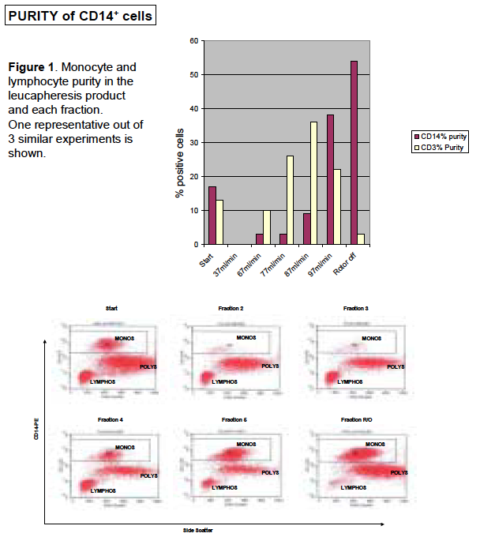
Clinical Scale Cryopreserved PBSC Elutriation for Monocyte Enrichment
Ahmed et al ISCT meeting 2005
Clinical ‘discard’ PBSC harvests, rapidly thawed in a 37⁰C water bath. Slowly mixed 1:2 with wash solution (Composol™ PS with 1% HSA and 5mM EDTA).
Cells connected to the Elutra sterile disposable set and fractions collected after stepwise increase in media (PBS/1% HSA) flow rate (37-67-77-87-97 ml/min) at constant centrifuge speed (2400rpm).
Yields
CD14+ monocyte 68%
T-cells 4%
Total WBC yield 85%
Purity
CD14+ Monocytes 54%
Granulocytes 40%
T-Cells 4%
(NB: PBSC with much lower granulocyte contamination required to improve monocyte purity)

Slide 12
Proposed Pre-Clinical Thaw Method Testing for CD34 Selection
NB: A thaw method that result in improved cell yield/viability/stability would be of great value for many cryopreserved products. For laboratory QC, cell processing, or clinical use, independently of immunomagnetic CD34 selection testing
1. Ensure that Plasma-Lyte 4% HSA is as effective as current ‘CliniMACS buffer’ (PBS 1% HSA, EDTA) for CD34 purification (miniMACS)
2. Simple ‘WBC clumping test’ counts (similar to Koizumi) of matched HPC cryovials
Compare Plasmalyte with 4% HSA at 4⁰C versus RT (CD34 wash/incubation protocol steps)
Take WBC count after each step to determine cell losses
May vary reconstitution timing or minimise centrifugation if necessary
3. Select most successful condition(s), repeat and include flow viable CD34 counts
4. Most successful, could add miniMACS testing, (possibly CFU)
5. Full scale (current) CliniMACS method versus CliniMACS II and New Cell washer or versus Miltenyi Prodigy

