Slide 1

The road to licensing a CDMO
Kelly Balsom
Advent Bioservices

Slide 2
At SCUG 2019:
Regulations surrounding ATMPs
“Benefit and handicap of starting with a (relatively) clean slate
Started with an empty warehouse and are building it up to provide:
  Cleanroom space for ATMP manufacture, clinical trial work, process development work
  In-house testing capabilities for QC
  In-house training facilities
  Cryostorage facilities
Challenges are vast!”
Our aim in 2019 was to achieve an MHRA Specials license to manufacture ATMPs at our Sawston facility

Slide 3
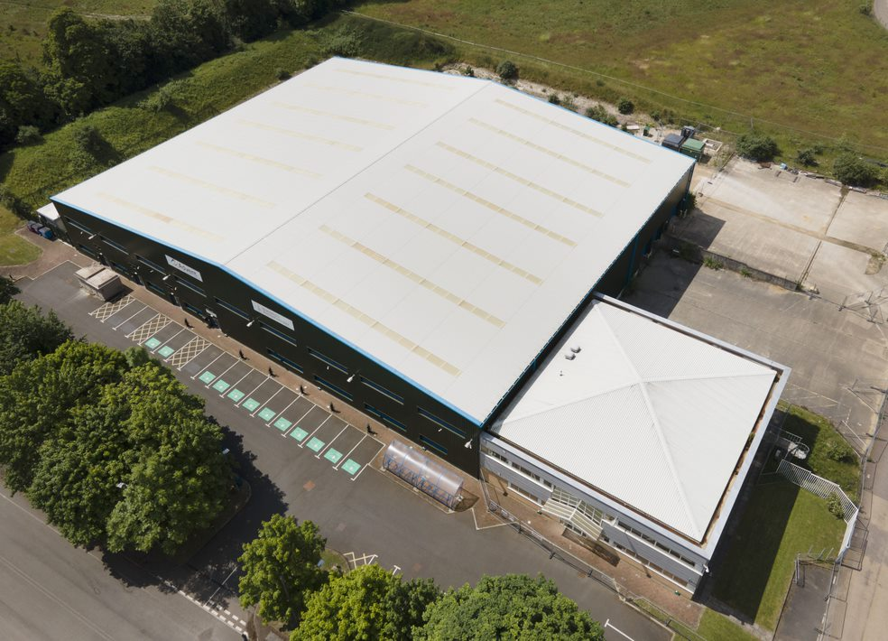
Sawston Site
90,000 sq/ft
Cambridgeshire, an excellent location for a CDMO
Close to Biotec hubs in Cambridge and Stevenage
Good road access to Stansted and M11
Good rail access

Slide 4

Advanced Therapeutic Medicinal Products - ATMPs
ATMPs have revolutionised patient specific treatment for a wide variety of disorders
Many of these new therapies share similarities with stem cell transplantation yet are classed as ‘medicines’
Therefore, legislation around ATMPs is vast and complex
HTA
Procurement, testing, processing, storage, and distribution of human cells and tissue for human application (among other areas)
This extends to licensing procurement and testing of human cells for manufacture of an ATMP
MHRA
Competent authority for clinical trial authorisation for all medicinal products, including ATMPs and for UK manufacturers or importers of ATMPs
JACIE
Defines standards for the procurement, testing and clinical administration of cellular therapy products (stem cells and immune effector cells (IECs))
Notes:
Here I will address which bodies regulate ATMPs and the challenges facing a CDMO

Slide 5
Manufacture - MHRA
ATMPs started by being manufactured in academic settings
Since commercialisation of some ATMPs (such as CAR-T’s) product numbers are increasing and extra lab space and expertise is now required Catapult Annual Report (nov 2021)
  1,500 jobs and 12,500m² in2019
  3,000 jobs and 20,000m² in 2020
  3,300 jobs and 31,800m² in 2021
Increase in clinical trials
  14 Phase III clinical trials in 2019
  28 Phase III clinical trails in 2020
  38 Phase III clinical trials in 2021
Contract Development and Manufacturing Organisations (CDMOs) are starting to emerge (such as the Roslin Institute and Advent Bioservices), where manufacture can take place

Slide 6
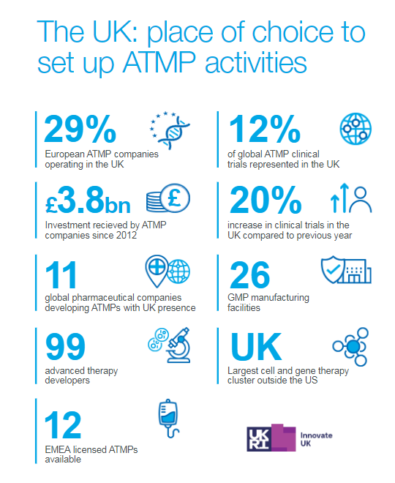

Catapult annual report 2021

Slide 7
Aim 2019: MHRA ‘Specials’ License
Products without marketing authorisation can be manufactured under the MHRA Specials license (see Guidance Note 14)
A “special” may only be supplied to third parties if all of the following apply:
  there is an unsolicited order;
  the product is manufactured and assembled in accordance with the specification of a person who is a doctor (or other prescriber) registered in the UK;
  product is for use by a patient for whose treatment that person is directly responsible in order to fulfil the special needs of that patient; and
  the product is manufactured and supplied under specific conditions
The manufacturing/assembly site and its operations will be inspected for compliance with (GMP) and the conditions of the licence.
Release of “specials” should be by the quality controller or a nominated deputy.

Slide 8
Advent Bioservices Timeline 2015-2022
Advent Bioservices incorporated from Cognate UK
Phase 1:
Sawston facility 2 x 250m² Hotel Suites construction completed
Manufacture of Stem Cells started at RFH
Sep 2021:
HTA licence granted
Mar 2022:
Patient Manufacturing started in Sawston
Sept 2020:
Equipment validation at Sawston started
Patient manufacturing started at RFH
Dec 2021:
MHRA licence granted
2015
2016
2017
2018
2019
2020
2021
2022
Technology transfer of Autologous dendritic cells manufacturing under the 'Specials' licence at the RFH
Oct 2020:
Phase 1a build complete
QC, Cryostore, PD, HS1 C lab extension
Q2 2021
Cleanroom PQ performed
Aug 2021:
Freezer facility / Warehouse build complete
Sawston facility design completed
>7900m²
Contract with Royal Free Hospital signed for manufacturing under RFH 'Specials' licence
2021 staff levels: 38
2022 staff levels: 60

Slide 9
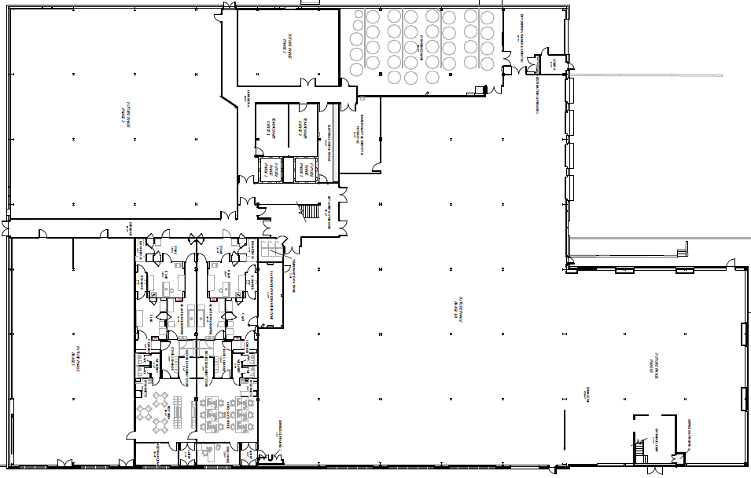
Overview of Build

Slide 10
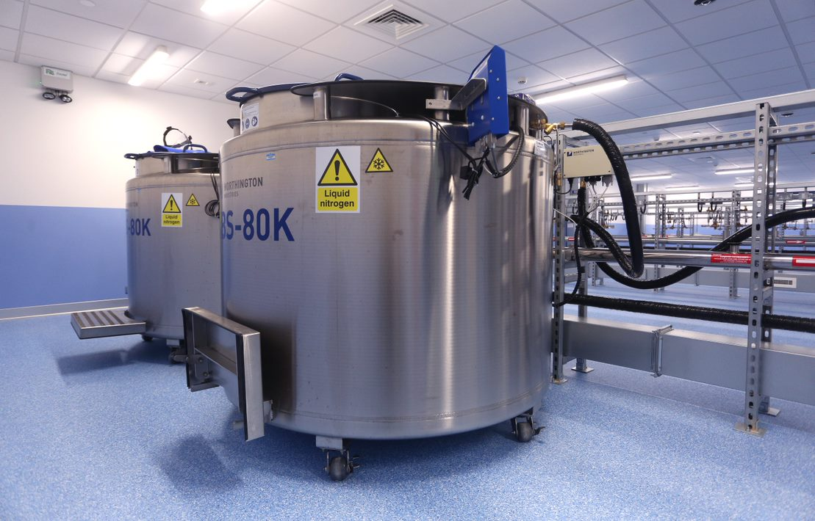
Cryostore
  State of the art design
  LN2 generated on site
  4 SIVL to service up to 36 large LN₂ dewars (capacity ~ 2.8 million vials)
  Continuous monitoring and management via remote system called Sintesy

Slide 11
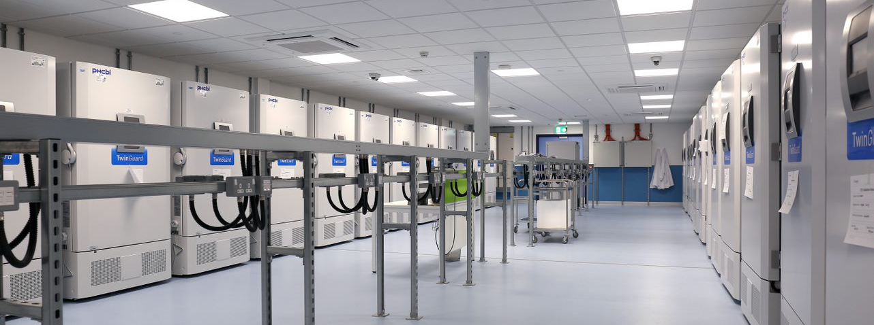
Freezer Facility
  Currently 30 freezers
  Can accommodate up to 60 freezers
  Continuous monitoring via the EMS
  Reception and office area for clients
  Easy access

Slide 12
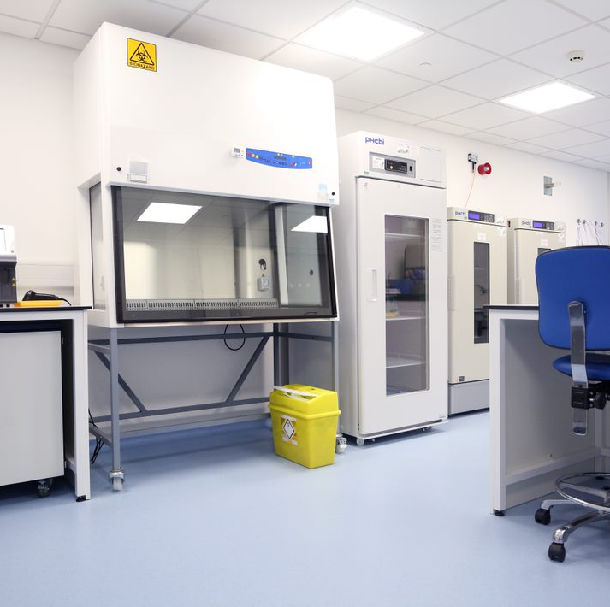
QC Lab
  Validated services include:
    Environmental Monitoring
    Cell counting
    Flow cytometry
    Protein assay
    Sterility (BacTec) under validation

Slide 13
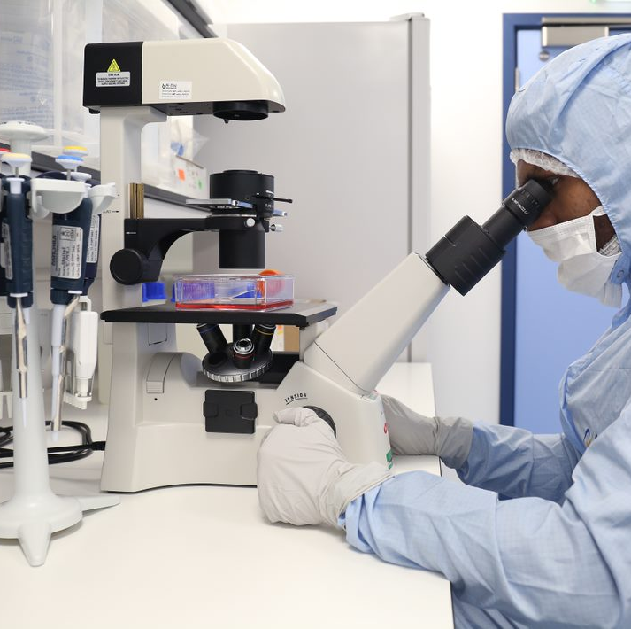
Process Development
Lab
Designed and fitted to support development of current and future projects
Team expanding with appointment of Head of PD and R&D
Master/ working cell banking work
Automation of manufacturing processes

Slide 14
HTA License
Remote inspection July 2021
License for storage and distribution of human cells and tissues for human application granted September 2021
License number: 22694

Slide 15
MHRA License
Application submitted May 2021
On-site inspection over 4 days October 2021
License for MIA(IMP) and Manufacturing Specials (MS) granted December 2021
License number: 54923

Slide 16
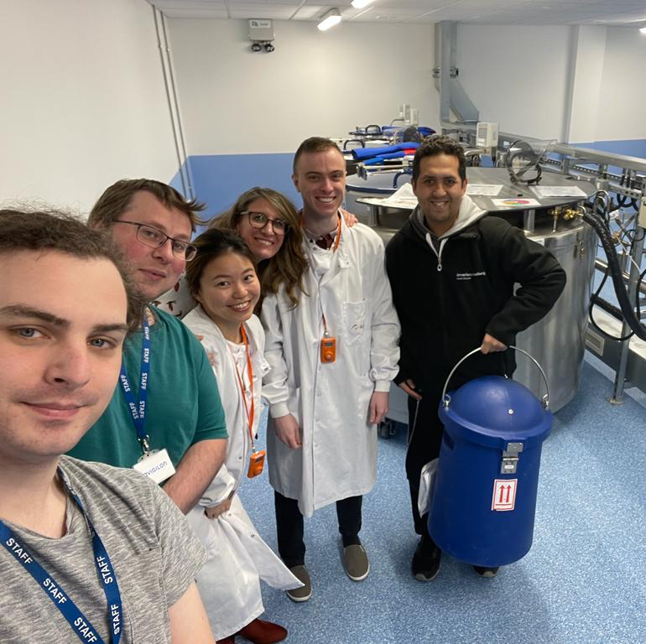
Post MS/ MIA(IMP) licensing
Tech Transfer from RFH to Sawston
First patient manufacture and administration
Biobank/Cryoservice went live
  Client samples on site
LIMS phase 1 implementation (warehouse)
eBMR configuration has began, due August 2022 with Autolomous

Slide 17
Challenges:
At SCUG 2019: Regulations surrounding ATMPs
CDMO
IT infrastructure
Website
Quality & Licensing
HTA
HR & Recruitment
Building infrastructure
Equipment and consumable procurement
Validating facility / equipment / processes
eBMR
eQMS
BMS
LIMS
Marketing
MHRA
Cryostore management
Warehouse management
IQ/OQ/PQ
FAT/SAT
VMP
QMS
Offices
QC lab
Aseptic suites
Cryostore
Warehouse

Slide 18
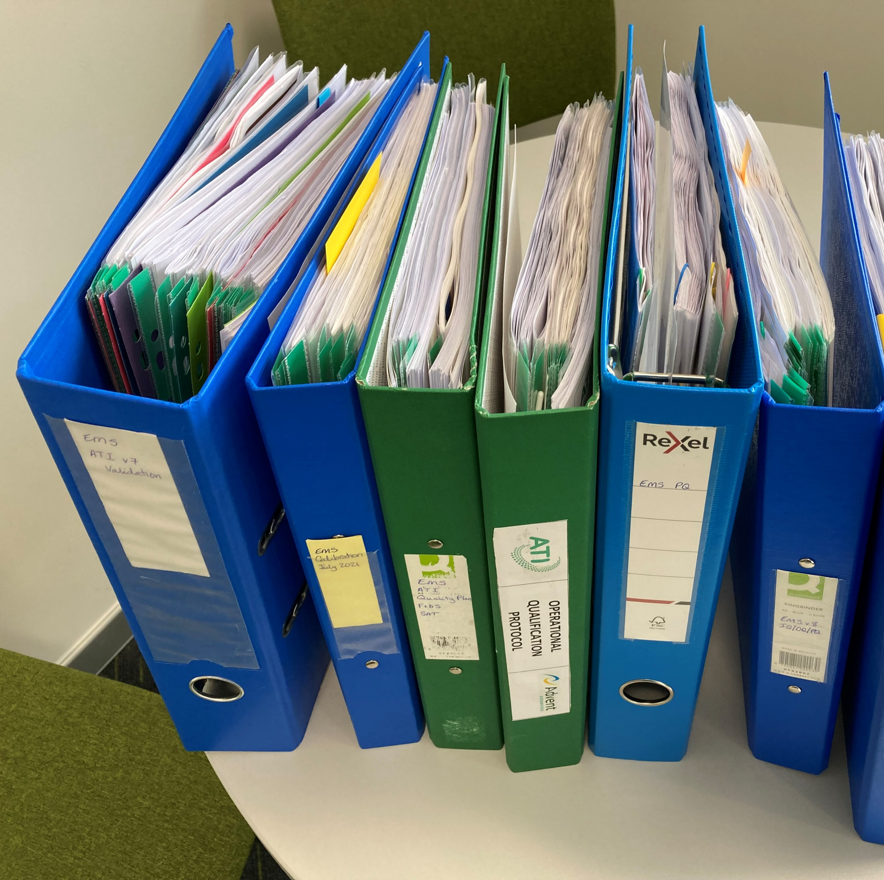
Challenges: Validation
Full Validation Team including Validation Lead and a CSV Lead
Everything needs validation from suppliers, equipment, facilities and processes
Example - Environmental Monitoring System
  6 months from start to finish
  Further validation each time a new probe is added

Slide 19
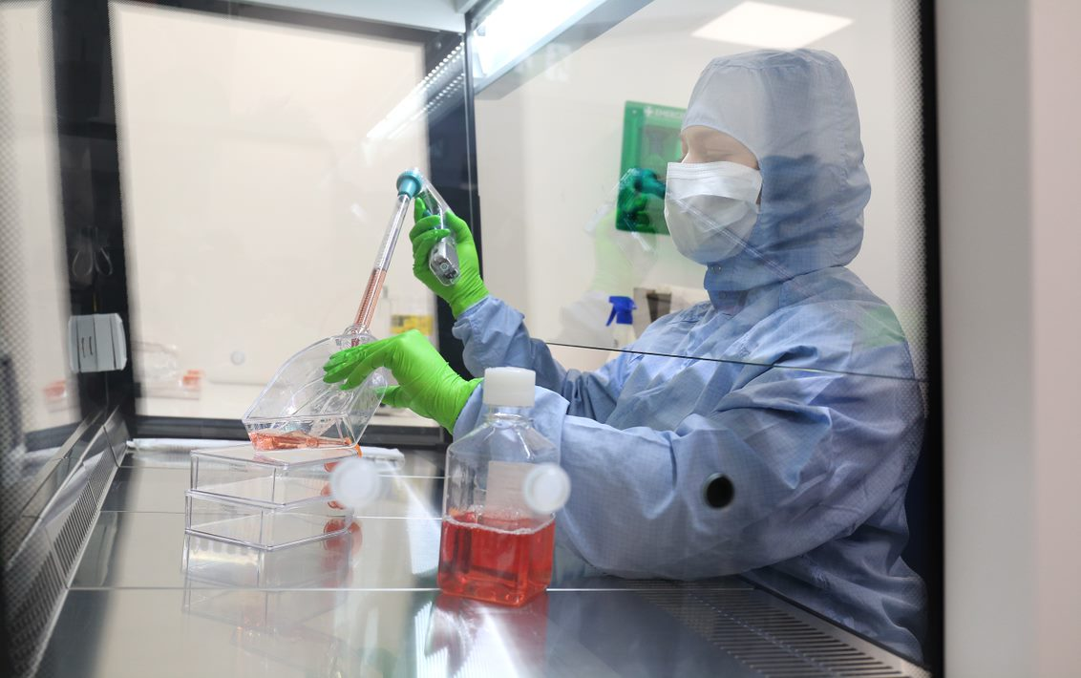
Challenges: Validating the cleanrooms
An extensive 6-week PQ was performed to fully test the performance of the suite under simulated operating conditions
  Gowning, transfer of items
  Cleaning justification
  EM justification
  Operator qualification
  Air handling
  EMS

Slide 20




Challenges:
IT Systems
Systems in use:
  QMS provided by Q-Pulse – configured, validated and in use from 2020
  EMS is provided by ATI and Lighthouse and comprises a full system for temperature, humidity, pressure, continuous non-viable particle monitoring, CO₂ levels. Fully validated to current version.
  Cryostore management and monitoring is provided by Sintesy
  Website up and running www.adventbio.uk
Systems in progress:
  LIMS is provided by Labware – staged implementation, phase 1 complete, next phases coming on line in coming weeks, due Q4 2022
  eBMR system provided by Autolomous – undergoing configuration, due Q3 2022.

Slide 21
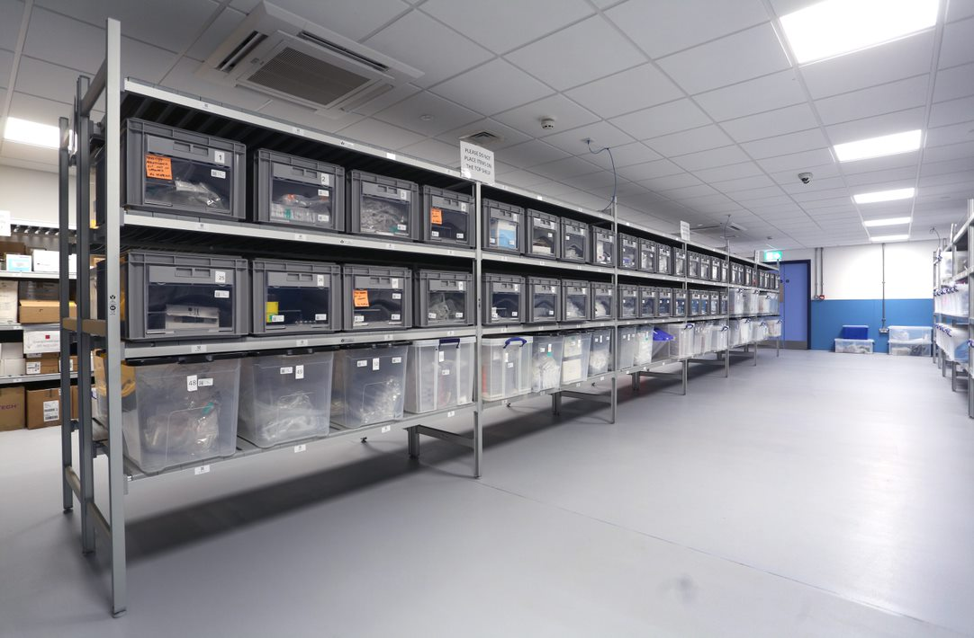
Challenges: Warehousing
Having enough warehouse space is a constant challenge for a CDMO
Each project / product has its own consumables requirments
Fully temperature controlled and mapped space
Fully electronic inventory system from receipt to picking

Slide 22
Now in 2022: Our Aims/Ethos
Advent Bioservices provides a comprehensive CDMO service to the cell therapy industry;
  Supporting companies with the development and manufacture of ATMPs
  Assist in the delivery of clinical trial products
  Provision of a comprehensive QC testing service
  Provision of product release and QP certification
  Cold and ultra-cold (cryogenic) storage solutions
Our ethos is to culture, develop and strengthen partnerships with clients involved in the advancement of patient treatment

Slide 23
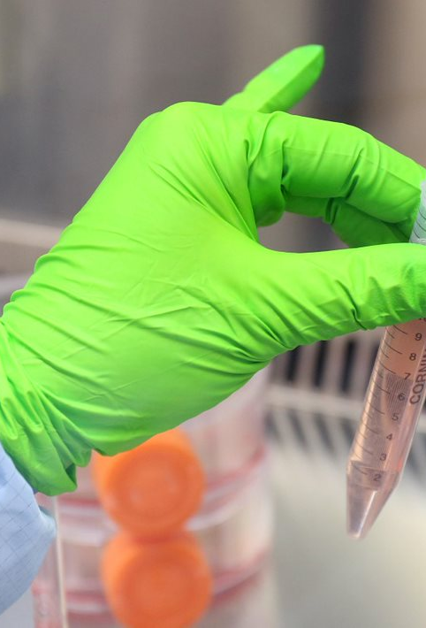
Future
Implementing a fill finish system
Expand QC services to provide full release service for external clients
Expand PD services
LIMS
  Phase 2 – Biobank inventory
  Phase 3 – Patient sample handling
  Phase 4 – QC equipment implementation
On boarding new clients for CDMO services and Biobanking/ Cryostorage
eBMR implementation
JACIE accreditation

