Slide 1

In person, Virtual and Hybrid Inspections
Stem Cell User Group Meeting 33
June 2022
Anne Emmett
Quality Manager
JACIE Inspector

Slide 2
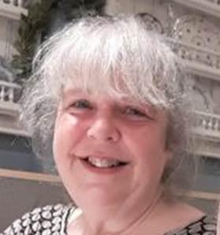

Hello!
I am Anne Emmett
Great Ormond Street Hospital
You can find me at anne.emmett@nhs.net

Slide 3



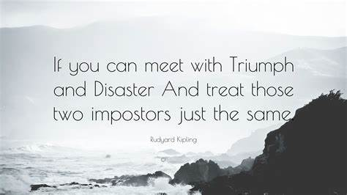







With any inspection – HTA, NHSE, CQC, Trials, JACIE – they will all require documents loading onto some kind of data base and, normally, some kind of matrix to be filled in. Some are a triumph and easy to fill in… others not so good!
Try to treat all inspections consistently – what ‘type’ of inspection it is shouldn’t matter.

Slide 4













IT considerations

Slide 5

Data sharing - considerations
https://ico.org.uk/ Primarily concerned with personal data, but can be adapted to sharing any information – SOPS, Databases etc.
Data Protection Impact Assessment

Slide 6
How should you share the information?
You must share information securely.
You must ensure you are giving the information to the right recipient.
What is to happen to the data at every stage?
Who in each organisation can access the shared data? Ensure it is restricted to authorised personnel in each organisation.
What common retention periods for data do you all agree to?
What processes do you need to ensure secure deletion takes place?

Slide 7

Documents - a list of documents to be provided by the centre in advance will be requested by the auditing/inspecting organisation.
There may be some additional documents not already requested that should be supplied – if part of evidence for compliance.
If there is a delay between submission and inspection check that where documents have been submitted, any documents that have since been updated should be provided.

Slide 8

If you are asked to provide anything ‘inappropriate’ feel free to say no.
Examples would be:
video of patient areas – need consent from everyone who ‘might’ appear in video. A series of photos can be easier to control and edit.
Upload of patient data – this would need to be redacted/anonymised to extent it may be pointless.
Remind In Person inspectors of your filming/photography rules.

Slide 9
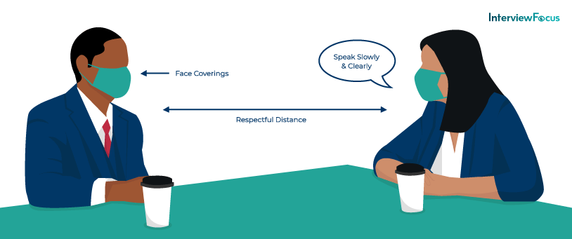
In person inspections
Book rooms
Book refreshments
Get computer access for inspectors
Brief everyone who will be involved – or may be in area. Inspectors can ask ‘anyone’ questions
Have a tidy up!
Consider if those in interviews will be more comfortable abiding by some degree of social distancing

Slide 10

Virtual Inspections
Book rooms if interviews would be difficult in communal office spaces – background noise etc.
Make sure you can access the database for document uploads
Make sure you will be able to access interview platform – no Trust Firewalls in place.
Upload documents well in advance, and ideally not on ‘last day’ of upload period
If interviews will be with staff WFH make sure they can access systems and have good broadband.
Brief everyone who will be involved
Have a tidy up if a ‘walk round’ video on the day

Slide 11

Hybrid Inspections
In some ways worst of both worlds.
You may have fewer actual inspectors on site, but you still need to do all the prep work for both In person and Virtual inspections.

Slide 12
Some deferments of re-accreditation inspections have taken place – this is not an excuse to rest….
Keep everything up to date, so that when your inspection does come around you are ready.

Slide 13


Notes:
Be nice to your QM – they tend to work in a bit of an isolated field. Treat them to something nice after any inspections!

Slide 14

Any questions?

