Slide 1

Designing GMP processes to generate ATMPs consistently
-Arindam Mitra,
Assoc Director, Manufacturing
leucid.com
CONFIDENTIAL. Copyright © Leucid Bio Ltd 2022

Slide 2

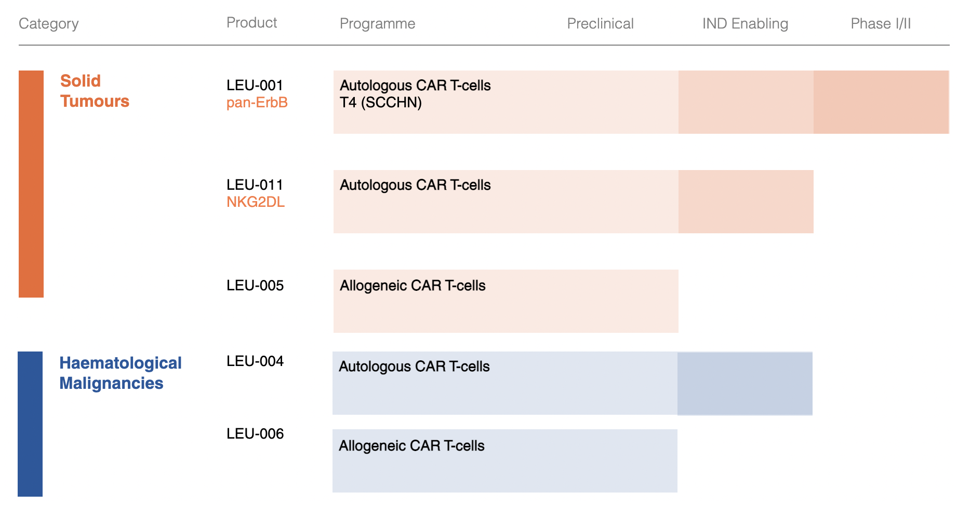
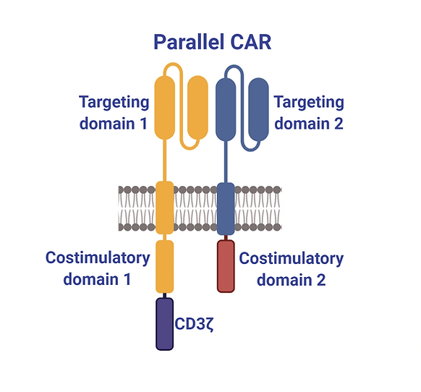
About Us

Slide 3
Definitions
R&D- Research and Development
GMP- Good Manufacturing Practice (Medicines Manufacture principles)
QTPP- Quality Target Product Profile
IMP- Investigative Medicinal products
ATMP- Advanced Therapy Medicinal Product

Slide 4
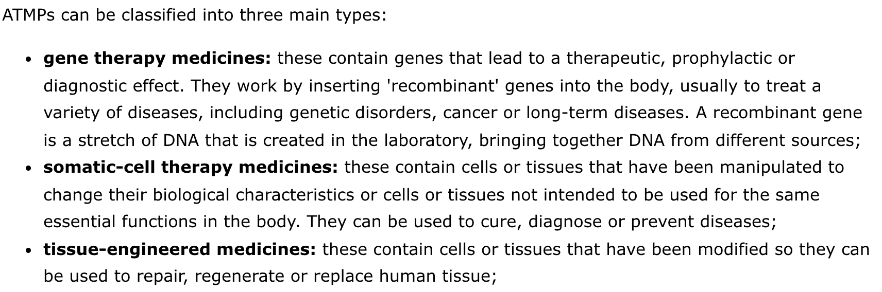
Definitions

Slide 5
The landscape
The two elements..
R&D - GMP

Slide 6
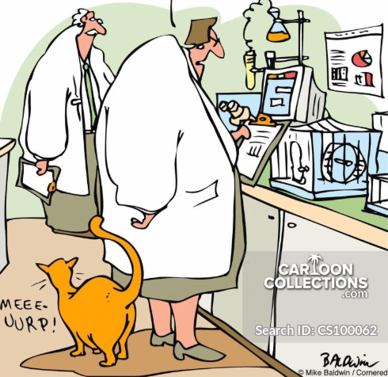
Research Environment
Processes are generally open; e.g. cell culture flasks, Falcon tubes, centrifugation, etc.
Laboratory notebook for recording data (ad hoc notes; non-systematic recording process)
Traceability is present in some cases (but limited)

Slide 7
Research Environment
Testing of raw materials is not performed
Research grade reagents
Different mindset
Uncontrolled environment
Limited (if any) in-process controls (QC testing)

Slide 8
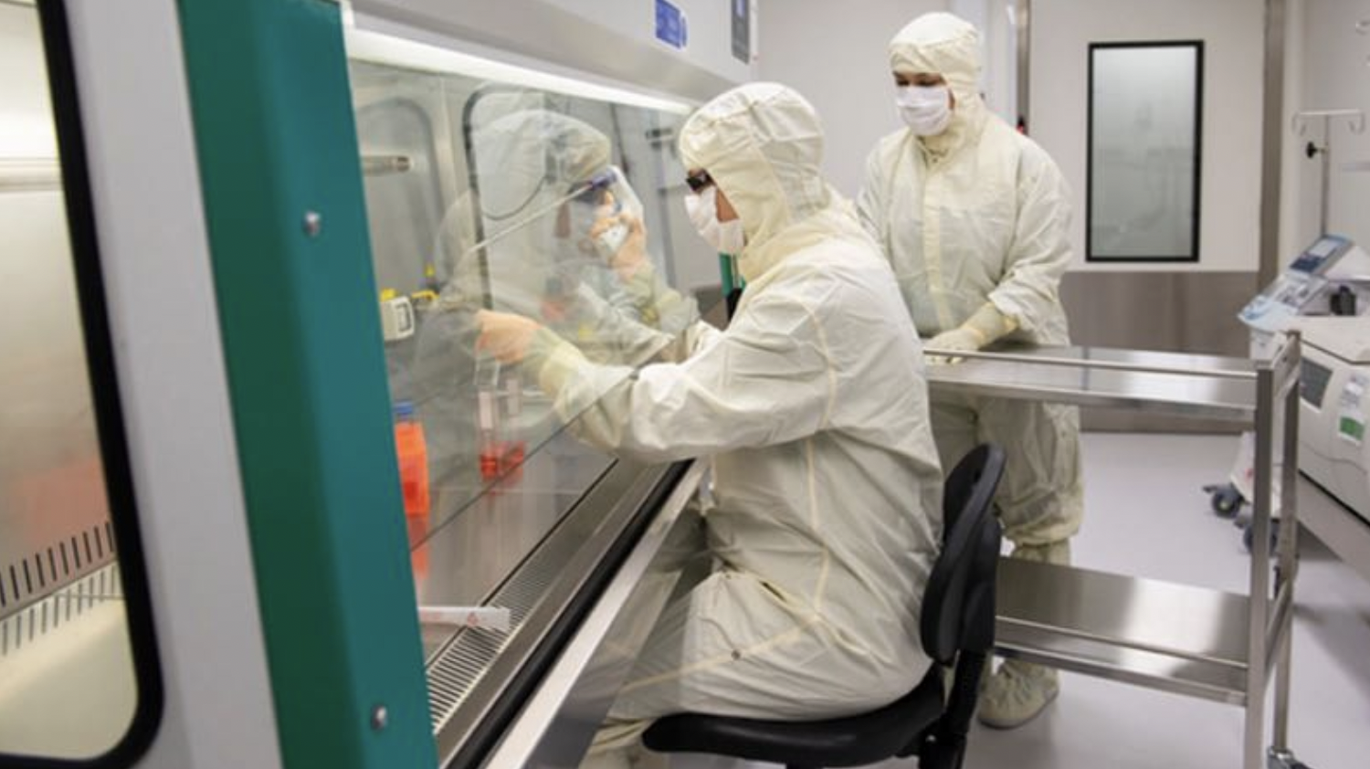
GMP Environment

Slide 9
GMP Environment (Medicine Manufacture)
Processes are “generally " closed and scaled up
Data recorded in approved and version-controlled batch records and all raw data attached
Data traceability is of paramount importance
Raw materials are tested and released
GMP reagents (More expensive)

Slide 10
GMP Environment (Medicine Manufacture)
Environmental monitoring
Product Specification File for products
Risk-based approach is incorporated (RBA)
QP certification & batch release is a requirement

Slide 11
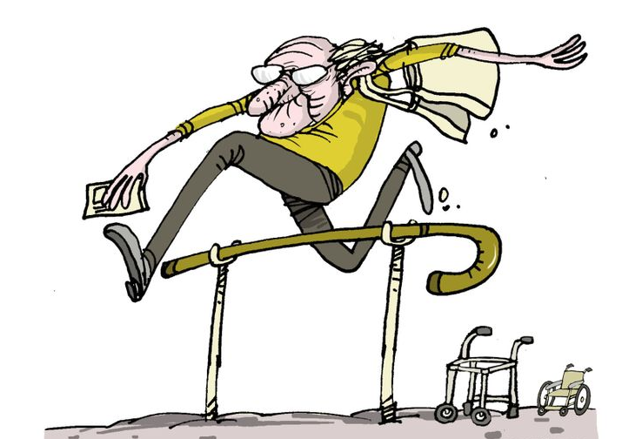
Challenges or Opportunities ?
Finding appropriate raw materials
Closing a process (Lots of process development)
Restrictions of working in a GMP environment
Understanding the requirements of “Sterile Manufacture” and scale up (can be complex)
Change of mindset (GMP: great mounds of paperwork!)
Stability testing of cellular products can be tricky
Assessing product quality e.g .Validated potency assays
Different equipment/facilities/operators

Slide 12
Technology Transfer Essentials
Process Design
Process Monitoring
Process Qualification
©FDA- Tech Transfer

Slide 13
Technology Transfer Essentials
Monitor
Critical design attributes
Critical process parameters (CPP)
Critical quality attributes (CQA)
Process Monitoring

Slide 14
Technology Transfer Essentials
Process Design
Define the knowledge space e.g. development experience
Comprehensive product design ensures more robust products
Process Design

Slide 15
Technology Transfer Essentials
Process Qualification
Equipment /Facility /Utility Qualification
Assures process performance
Assures constancy in manufacturing
Process Qualification

Slide 16
Technology Transfer Essentials
Honest communication between teams
1
Feasibility
Gap Analysis and risk assessment of the research process
2
Determine responsibilities for each group and individuals
3
Process-Specific stages
4
Creating a process flow diagram
5
Timing it right e.g. engineering runs, early planning can help avoid pitfalls
6
GMP management for the initiation of the process
7
Personnel Specific stages
8
Ensuring the required knowledge and expertise is present within the team
9
Training of staff to GMP standards, ensuring competency

Slide 17
Opportunities
Develop and train transfer teams
Refine process imperfections during process development
Create robust critical process parameters
Use the knowledge gathered in research scale to build manufacturing controls
Offering clinical products to patients who need it
ICH Q10- “The goal of technology transfer activities is to transfer product and process knowledge between development and manufacturing, and within or between manufacturing sites to achieve product realization. This knowledge forms the basis for the manufacturing process, control strategy, process validation approach and ongoing continual improvement”.

Slide 18
Opportunities
Successful manufacture of engineering run batches
Staff training during engineering runs
Effective technology transfer can be achieved through a Tech transfer by design(TTbd) process , with predefined objectives which emphasizes on process understanding and process control based on good science and quality risk management.

Slide 19
Case Study 1
Autologous T cells with TCR α Wilems Tumour Gene 1 (WT-1)
Wilms’ Tumour Antigen 1 (WT1) is a non-polymorphic intracellular protein that promotes proliferation and oncogenicity in AML
Over-expressed 10–1000× in AML, including leukemic stem cells, compared to normal CD34⁺cells
Physiologic WT1 expression is limited to low levels in a few adult tissues, predominantly kidney podocytes, mesothelial lining cells and hematopoietic CD34⁺ stem cells

Slide 20
Autologous T cells with TCR α Wilems Tumour Gene 1 (WT-1)
Isolate T cells from Apheresis
Transduce with a retroviral vector
Expand cells to large numbers
Formulate and Freeze

Slide 21
R&D Method
Small scale isolations in lab using isolation columns yielded high purity and recovery
Spinoculation model used for viral transduction
Cells grown on plates after αCD3/CD28 stimulation yielded good cell numbers
No formulation methodologies, cells frozen in cryovials vials
QC included Phenotype and functionality (Killing Assay)

Slide 22
Scaled up method issues..
Isolation using closed system MACS initially yielded low purity and cell numbers with loss of viability
Transduction efficiency of T cells with vector was low (~10-30%)
Cell expansion using the bioreactor was poor
Formulation and Freeze strategy developed was fit for its intended use

Slide 23
Scaled up method issues..
Large scale isolation did not consider cell: bead ratio, buffer temperatures, on-specific binding
( Possible TCR cross reactivity leading to poor viability post selection).
Transduction efficiency low- Transduction at large scale not optimised, no consideration initially on culture volume and virus MOI
Expansion rates poor – No consideration given to optimum bioreactor system, bead: cell ratio , stimulation and cell feed pattern ,work on cytokine cocktail for ideal phenotype wasn’t performed
Quality product target profile was not developed

Slide 24
Resolution ..
PBMC isolation and wash using the LOVO .
Optimum bead to cell ratio during isolation identified, buffers and collection bags kept cold to reduce activation and loss of viability ( This should lead to the selection of the ideal cell selection system)…Considerations to other technologies??.
Cell growth optimised using the right blend of cells: beads (CD3/CD28), giving consideration to density (cell/surface area) is very important possibly more than concentration/ml..
Transduction improved by optimising culture volumes and MOI (Very important when considering closed systems)
DoE approach used to identify target phenotype of cells and therefore choosing the right cocktail!
Killing assay alternatives ( Look at easier assays maybe flow based assays to consistently achieve the intended outcome)
Identify cellular impurities ( e.g. NK/NKT/B.. Treg cells)

Slide 25
Case Study 2
Autologous T_{regs}
Isolation of T cells
Expansion of T cell culture
Formulation Freeze
QC Assays

Slide 26
R&D Method
Isolate T cells using density based separation (not necessarily magnetic separation)
Grow T cells in small culture vessels
Beads are removed periodically
Expand cells to small numbers
Centrifuge and Wash
Formulate
Perform phenotype & Functionality assays

Slide 27
Scaled up method
Isolate T cells using magnetic separation (closed system)
Grow T cells in bioreactors to large numbers (Semi Closed)
Beads are not removed periodically
Centrifuge and Wash ?
Formulate and freeze!
Qualified Phenotype & functionality assays

Slide 28
Scaled up method issues..
Several open parts of the process
Long hours in the clean rooms
Harvest – many open steps ( long hours!)
Extremely manual and of long duration

Slide 29
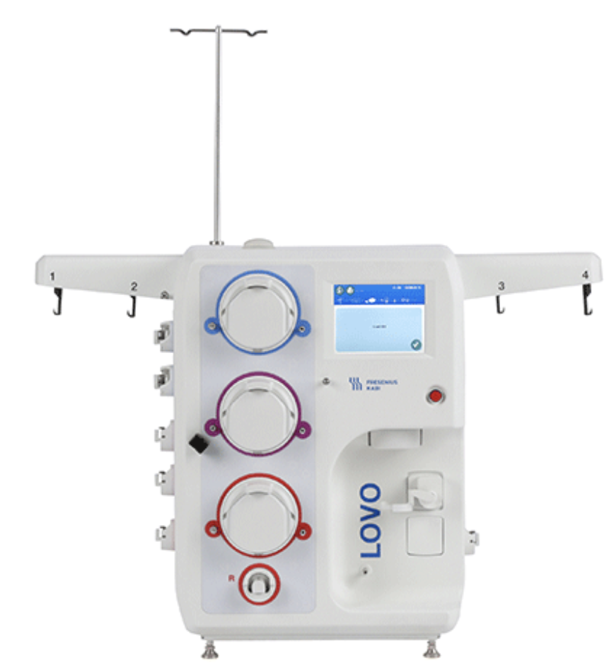
Introduction of a Closed System cell processor
Step :Centrifuge and Wash?
Formulate and freeze!
Tested the ability of the system to volume reduce ~10 L of cell culture to ~200 ml’s.
Small scale studies with cultured T cells
Looked at pre / post wash cell characteristics i. e. recovery, viability and phenotype
Performed qualification runs
Amended IMPD and introduced as process change

Slide 30
Introduction of a Closed System cell processor
Advantages
Time and cost saving
Preserves cellular characteristics
Can be integrated in upstream and downstream processing
Disadvantages
Upstream processing requires careful evaluation
May need introduction of additional reagents to get the intended outcome

Slide 31
Summary
Understand the complexity of cell therapy medicine manufacture, the more complicated the product ,the more time should be spent on developing ideas and qualifying them.
Research ideas often can’t be linearly scaled up without an understanding of manufacture science.
Splitting a process into several components and automating such components should be prioritised.
Shorter processing and culture times should be prioritised.
Simplicity should be of prime importance

Slide 32
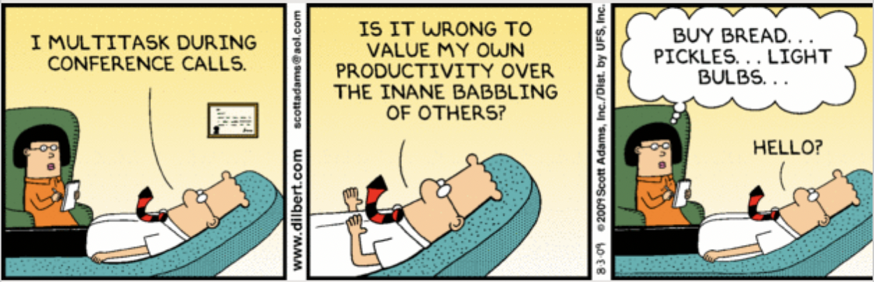
Thank You for listening! Any Questions?

