Slide 1

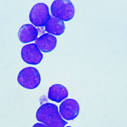
Impact of COVID-19 on Stem Cell Transplantation Stem Cell User Group, Nottingham June 2022
Rachel Pawson
Consultant Haematologist
Medical Director British Bone Marrow Registry and NHS Cord Blood Bank

Slide 2
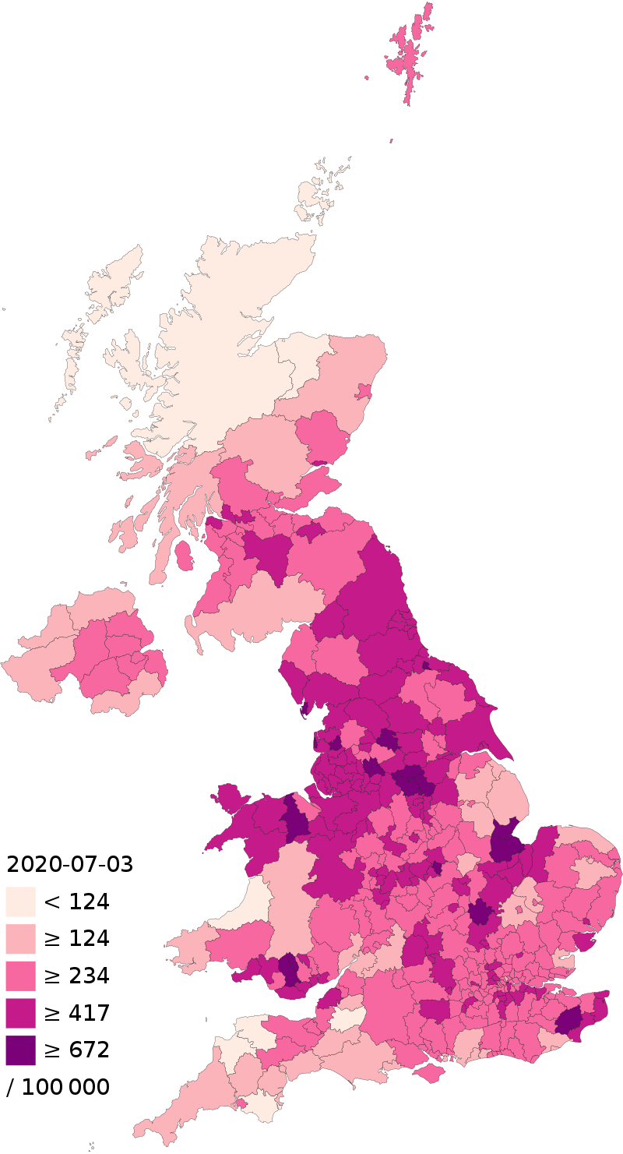
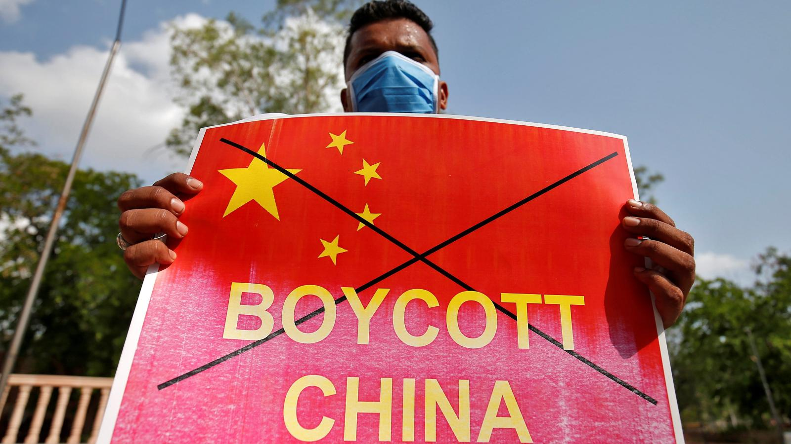
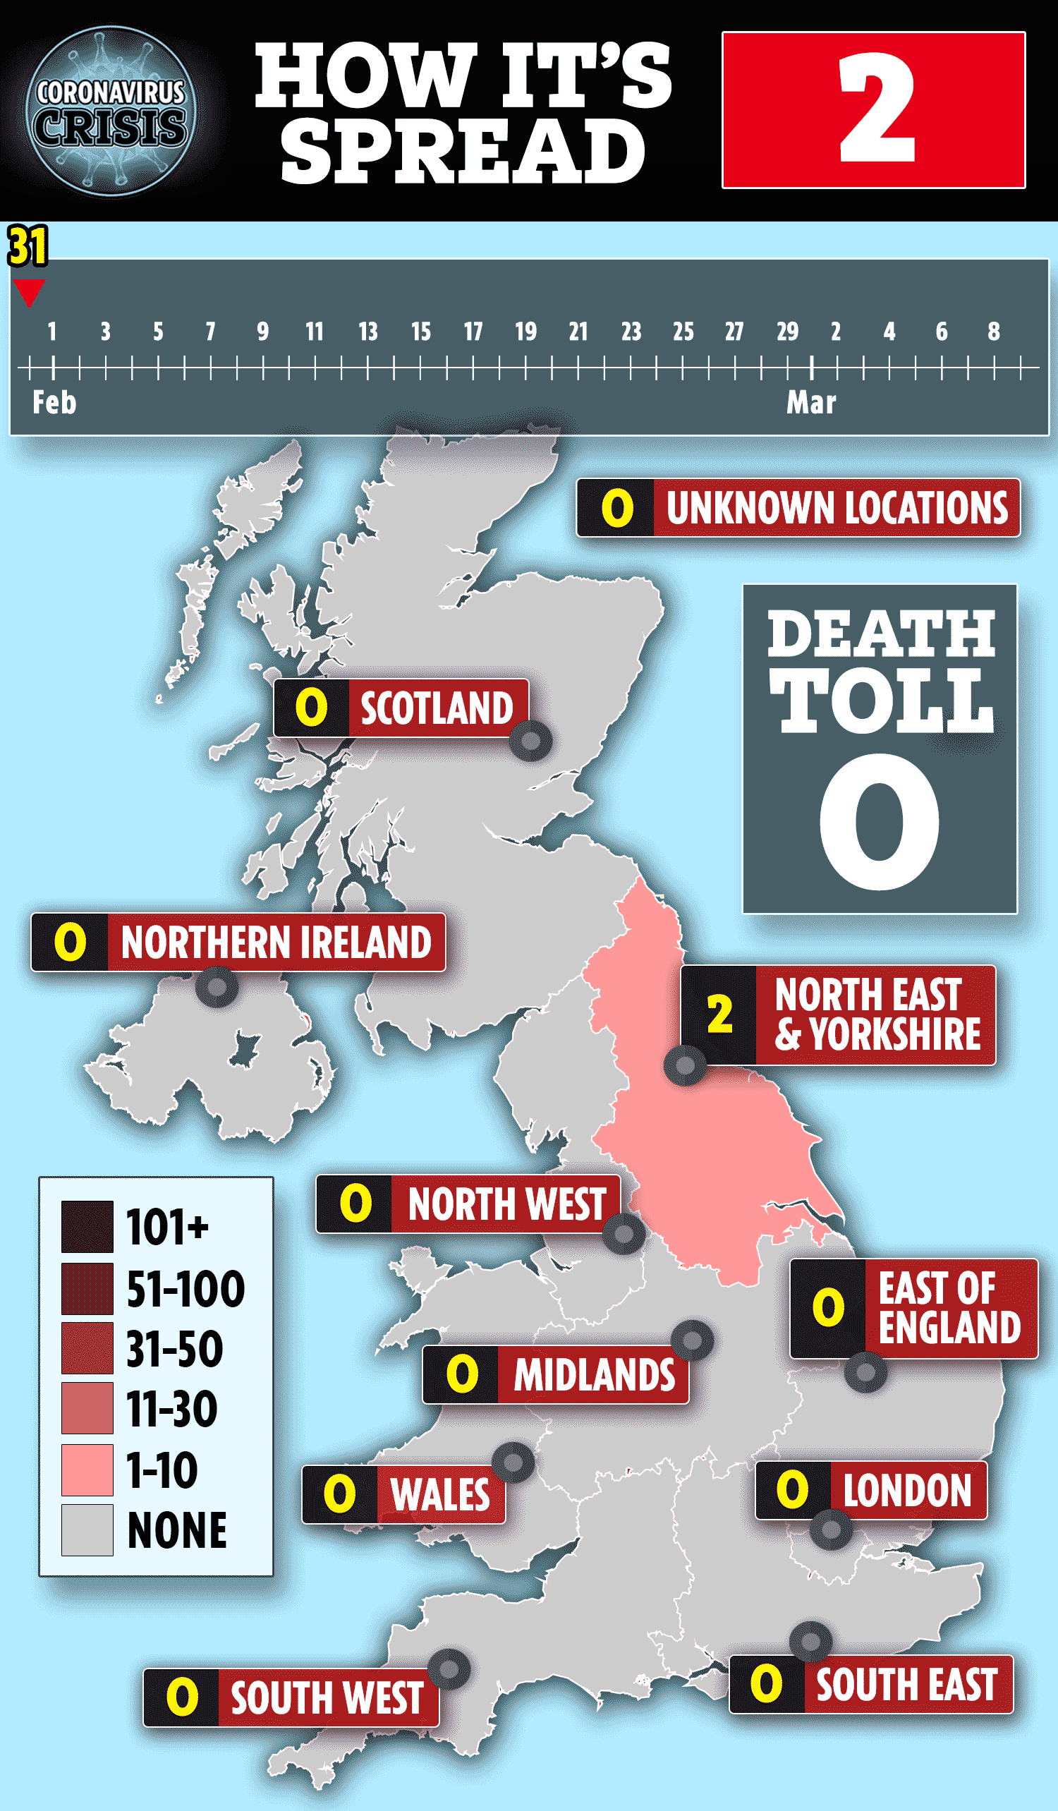
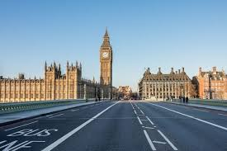
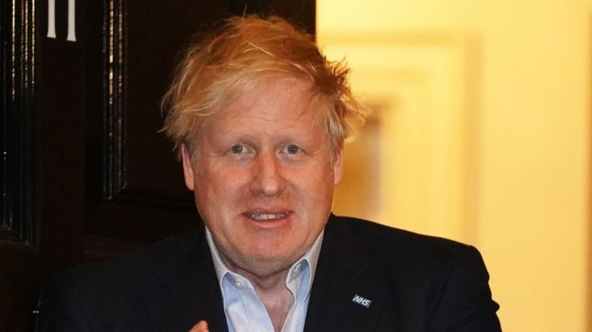

What Happened in UK?
Geographical exclusions”
First 2 cases in UK – tourists from China
First case transmitted in UK
UK in lockdown
PM admitted to hospital
3rd highest no. of deaths
Jan 23
Jan 31
Feb 28
Mar 23
April 5
July 25
-

Slide 3
Impact of COVID-19
Impact on recipients
Impact on donors
Impact on registries
Impact on transplant centres
Patient’s viewpoint
Cryopreservation - BSBMTCT study results
- WMDA SPEAR reports

Slide 4
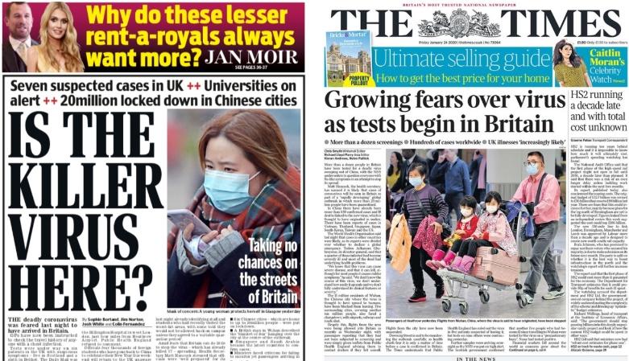
Notes:
Patients’ Concerns
Impact on recipients
Risk of infection in immunocompromised
Donor/product unavailability
Risk of COVID-19 transmission from donors

Slide 5

What if I Get It?
High morbidity rate – 20% ITU
High mortality rate - 14-23%
Similar for auto and allo patients
Worse prognosis if: <12 mths post-SCT
on immunosuppression
B-cell depleting treatments
Median time of onset post-SCT - allo 16 mths auto 23 mths
Above March-August 2020
CIBMTR 318 patients, Sharma et a,l 2021, Lancet Haematology
EBMT 382 patients, Ljungman et al, 2021, Leukemia
Review 2031 patients, Shahzad et al, 2022, Trans Infect Dis

Slide 6


In Oxford………..
Notes:
57 yr old friar diabetic hypertensive. 12 mths post MUD for SAA – on CSA nad pred – cough 18.4.20, better in 2 weeks

Slide 7
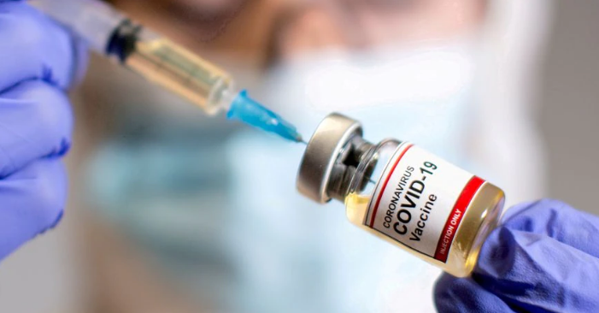
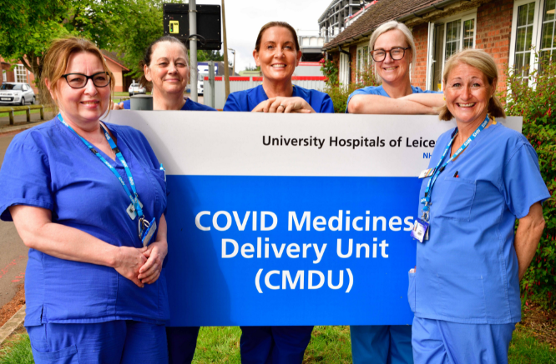
What if I Get It?
Impact of vaccination not clear yet
Covid-19 Medicine Delivery Units – 16th December 2021
Identify patients eligible for treatments
Triage assessment with clinician
Neutralising mAbs and antivirals
Paxlovid (oral – nirmatrelvir/ritonavir)
Sotrovimab (i.v.)
Remdesivir (i.v.)
Molnupiravir (i.v.)
Notes:
dual oral antiviral nirmatrelvir/ritonavir resulted in a relative risk reduction of hospitalisation or death by 89% (within 3 days of symptom onset) and 88% (within 5 days of symptom onset) compared to placebo in nonhospitalised, high-risk adults with COVID-19 (Hammond et al, 2022)
A three-day intravenous course of remdesivir administered within 7 days of COVID-19 symptom onset to non-hospitalised patients with risk factors for disease progression, resulted in a relative risk reduction of 87% in hospitalisation or death at day 28
All within 12 mths of GVHD; auto 12 mths;
oral antiviral molnupiravir administered within 5 days of COVID-19 symptom onset to high-risk, non-hospitalised patients resulted in a relative risk reduction of 30%
elative risk reduction in hospitalisation or death at day 29 by 79% in patients treated with sotrovimab compared with placebo
Photo of Leicester CMDU – treated 100 patients in 6 mths

Slide 8
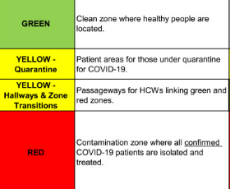
Will My Haematology Service Stay Open?
Outpatients – virtual clinics
Screening on arrival at hospital/pre-testing
Drive-through blood testing
Pharmacy courier services
Staff – minimal F2F staff meeting, splits
PPE
Testing/early access to vaccination
More stringent return-to-work criteria
Inpatients – postpone all non-urgent transplants (BSBMTCT, EBMT)
Testing
No visitors
Cessation of ambulatory care
Notes:
Changing guidelines
Multiple emails a day with changing advice

Slide 9


Will My Donor Be Able to Donate?
Collection facilities maintained – but BM difficult
Lockdowns, only essential travel
Avoidance of big cities
Cancellations due to donor reluctance very unusual
BBMR March – mid-June 2020
23% work-up requests were cancelled (vs 20% historical*)
55% of these were cancelled for donor reasons (vs 47% historical*)
DKMS March - November 2020
19.4% non-availability at work-up vs 19.3% in 2019
Notes:
87% of these were for reasons associated with COVID-19

Slide 10

What If My Donor Gets COVID-19?
Deferral for infection or risk of infection
Facility safety
Donor safety
Recipient safety
Donor safety:
Concerns re risk of G-CSF in donors with SARS-CoV-2 – 3 month deferral in 2020
Concerns re safety of general anaesthetic – 7 week deferral

Slide 11

Recipient Safety - Risk of COVID-19 Transmission from Donors?
WMDA SPEAR reports 2020
10 donors symptomatic or positive on day of donation (DoD)
7 underwent collections
Only 1 product used – patient had received conditioning
Recent BBMR donor
Positive on day one of HPC-A collection
Documented infection 25 days previously
Patient conditioned = cells infused
TC tested product for SARS-CoV-2 RNA - negative
Notes:
Is There a Risk of COVID-19 Transmission from Donors?
SARS-CoV-2 RNA can be detected in 15-40% of sick patients but rarely in pre-symptomatic patients
evidence regarding the risk that detectable RNA in blood can actually cause infection – i.e. viable/intact – is limited
other coronaviruses, including SARS-1 & MERS, have not been transmitted via blood or HPC

Slide 12

No Evidence of Transmission from Stem Cells
Patients |  | SC Source | Timing of Positive Test in Donor
1 AML adult | USA¹ | Unrelated BM | Day 2 post-donation | No infectious symptoms/signs at day14
1 paediatric allograft | Thai² | Sib BM | Day -1 | No infectious symptoms/signs at day 14
2 AML adults | France³ | Unrelated HPC-A | Day of donation | Negative up to 4 weeks
1 allograft | Spain⁴ | Sib | Day 2 post-donation | No infectious symptoms/signs
12 allograft patients | NMDP⁵ | Unrelated | Post-donation | No transmissions
1.Maakaron et al, BMT 2021;2 Anurathapan et al, BMT 2020; ³Leclerc et al, Lancet Haematology 2021
4. del Campo et al; 5. Stefanski, Blood 2021

Slide 13
Adverse Event Reports
on COVID-19 in Donors
No reports of:
Severe course in donor of COVID-19 during mobilization or donation
SARS-CoV2 infection of collection unit staff from donors
SARS-CoV2 transmission via blood products including HSC
Most registries not testing routinely
Less testing in community
Likely to be many transplants from SARS-CoV-2 –positive donors

Slide 14
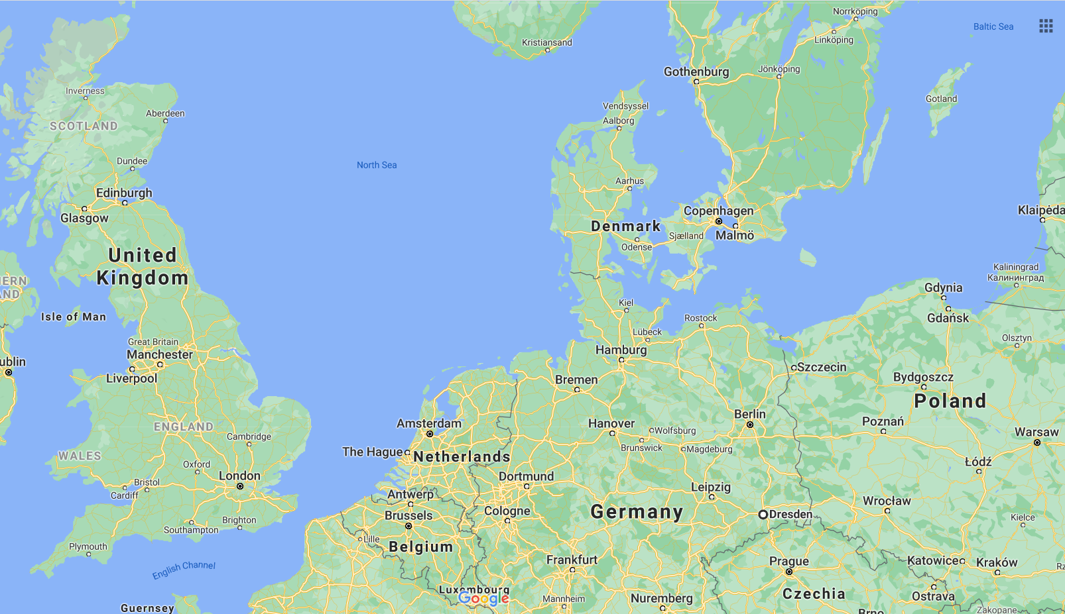

Will My Donation Be Able to Get to Me?
Notes:
I thought I’d share a case from the early days that highlights the unexpected issues we were, and still are, facing. We were importing cells from Poland for a patient in a London hospital. As you might remember, Poland was one of the first countries to close their borders and there were no exceptions.
The trip was originally planned as a volunteer courier trip, but we had to move to a commercial courier a week before, as those over 70 were asked to shield and we were concerned about our volunteers’ safety.
The courier trip was booked – a familiar route, from Krakow to Warsaw, Warsaw to London by plane.
Those first flights were cancelled, and the Polish border closed 5 days before the intended transport.
Our colleagues in Poland quickly established a process to drive products by ambulance to Slubice - on the border with Frankfurt am Oder in Germany. The courier’s trip was changed to take a car from the border to Berlin and then a flight from Berlin to London.
Those flights were cancelled and booked again for different times.
Then the new flights were cancelled and a train was booked from Berlin to Hannover, a flight from Hannover to Amsterdam and then Amsterdam to London

Slide 15



Notes:
.
On the day of transport, the Hannover and Amsterdam flights were cancelled. Ultimately, the courier travelled to the border at Frankfurt am Oder, where the cells were handed over on a bridge between Poland and Germany. He took a car from Frankfurt Am Oder to Dresden, a flight from Dresden to Frankfurt Am Main and then a flight from Frankfurt to London Heathrow.
At our Heathrow hub, which has been established just a few days prior, he handed the cells to an experienced Anthony Nolan volunteer courier, who delivered them to the patient.
The itinerary was changed 4 times and only finalised on the day of transport. The TC was obviously concerned, but we did everything we could to provide them with reassurance and keep them updated regularly. And they shared this feedback on the day, which they’ve allowed us to share with you:

Slide 16
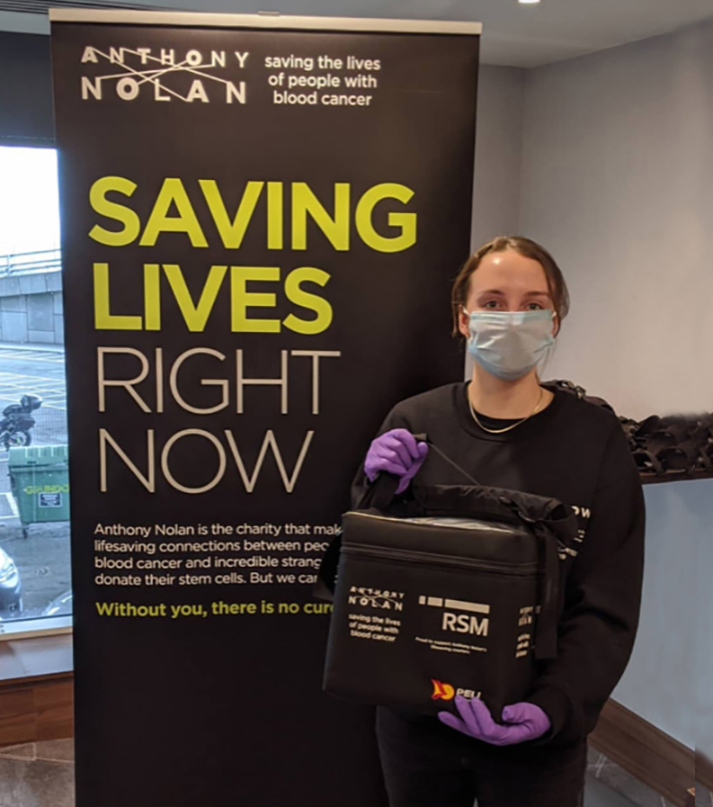

Slide 17
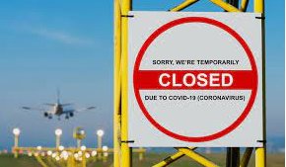
One Case of Failed Transport
Country with low export/import activity
International flights suspended 16/3/20
Product underwent emergency cryopreservation
24/3/20 no reinstatement or work around
Patient had cord blood transplant
Global trend diagram ^^^
diagram ^^^

Slide 18


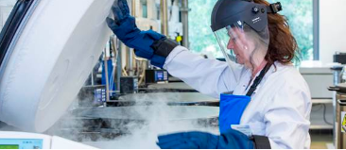
Will My Donation Work? Cryopreservation
March 2020
recommended cryopreservation of all allogeneic HSC donations
infrequent occurrence - 2% of all allogeneic HSC transplants¹
?impact on patient outcomes
¹ Frey et al 2006
Notes:
Historically limited to uncommon clinical scenarios related to unexpected donor availability, recipient deterioration or logistical issues

Slide 19
Pre-Pandemic Experience
Study | Fresh | Cryo | Cell Source | Neutrophils | Platelets | GVHD | OS
Medd Birmingham | 123 | 76 | All PBSC, RDs and UDs | Median 12 d in both; MVA – slight lag after day 12: probability of neut engraftment at D15 74% vs 93% fresh; D30 – same as fresh. Overall – trend to delayed cumulative neut engraftment with cryo PBSC (p=0.067) | Delayed 19d vs 14d | cGVHD higher | Same
Parody Sevilla | 107 | 224 | All PBSC RDs | Faster in frozen 14 vs 16 d | Same | aGVHD higher | Same
Alotaibi Canada | 648 | 310 | All PBSC RD,haplo,UD | No difference in neuts or graft failure | No difference | cGVHD higher | Same
MVA = multivariate analysisstudy

Slide 20
CIBMTR Retrospective * 2013-18
Study | Fresh | Cryo | Cell Source | Neutrophils | Platelets | GVHD | OS
Eapen | 194 | 52 | SAA only Sibs 41% MUD 31% BM in 64% | HR 2.26 for graft failure; MVA non-significant lower rate of neutrophil recovery (HR 0.76) | MVA non-significant lower rate of platelet recovery (HR 0.77) | No difference | 1yr HR 3.13; 73% vs 91% 1yr OS
Hamadani | 1080 | 274 | Post-TxCy 18 BM 256 PBSC | Similar rates of neut recovery | Similar | cGVHD lower - NSS | Same
Hsu* | 5514 | 1883 | 1051 MRD PBSC; 678 MUD PBSC; 154 MUD/MRD BM | BM no difference MRD PBSC – no difference UD PBSC delayed neuts (HR 0.77) (93% recovery at 28 days vs 97%); UD PBSC 5% graft failure vs 2% | Delayed in PBSCs: MRD (HR 0.73) and MUD (HR 0.61) | Increase with cryo MRD PBSC | Decrease OS with cryo MUD PBSC (HR 1.38); Reduced OS if cryo was for patient reasons
*Hsu study is only one of CIBMTR with neutrophil engraftment as primary endpoint*H
MVA = multivariate analysisstudy

Slide 21
Studies During Pandemic
Study | Fresh | Cryo | Cell Source | Neutrophils | Platelets | GVHD | OS
Fernandez-Sojo Barcelona | 32 | 32 | All PBSCs All UDs | Same (17.5 median vs 17 d) | Non-sign delay 25 vs 19 d | Same - NSS | Same
Bankova Stanford | 60 | 30 | More MUDs in cryo gp | Neuts slower 24d vs 18d in RICs; 13.3% graft failure in cryo vs 1.7% fresh ; Cryo RICs slower | Cryo RICs slower 27d vs 18d- NSS | - | Cryo RICs worse (R 2.2)
Purtill Australia | 613 | 191 Infused into 151 patients | All UDs. 188 HPC-A, 3 HPC-M | Same (17 days) Graft failure same (3 vs 4%) (included secondary) | Same (20 vs 21 days) | Not assessed | Not assessed (12% products not infused)
Maurer Boston | 203 | 101 | All PBSCs All MUDs | Neuts 1 day slower (15 vs 14d) Graft failure increased if product >48 hrs old – fresh and frozen | Platelets slower 21d vs 18 d | More aGVHD (but diff prep) | No diff at 6 mths Delayed chimerism

Slide 22
Does Graft Cryopreservation Affect the Outcomes of Allogeneic Haematopoietic Cell Transplants? A UK Multicentre Study During COVID-19 Pandemic
Dr Ruta Maniusyte
Anthony Nolan

Slide 23




Hello!
Rachel Pearce
Julia Lee
Marie Wilson
Dr Victoria Potter
Dr Ram Malladi
Prof. John A. Snowden
Dr Angharad Pryce Dr Robert Danby
Dr Ruta Maniusyte
Medical Officer
Dr Rachel Pawson

Slide 24
STUDY design I
Inclusion criteria:
Recipients receiving allogeneic HSC graft
PBSC and BM harvest
Adult and paediatric
Cryopreserved and fresh
Related and unrelated donors
UK centres
Exclusion criteria:
- Umbilical cord blood
Patient cohort:
Transplants performed 1st March 2020 to 31st May 2020
Historic controls March – May 2019

Slide 25
STUDY design II
Characteristics specific to:
Recipient
Disease
Donor
Graft
Outcomes recorded:
Neutrophil and platelet engraftment
1^{ary} and 2^{dary} graft failure
Acute GvHD (aGvHD)
Progression free survival (PFS)
Overall survival (OS)
Notes:
Infusion-related adverse events. Toxicities or adverse events reported as clinically related to infusion of graft.
Neutrophil engraftment. The time from transplantation to the first of three consecutive days with a neutrophil count ≥ 0.5x10⁹/l.
Platelet engraftment. The time from transplantation to the first of three consecutive days with a platelet count ≥ 20x10⁹/l and ≥ 50x10⁹/l (unsupported).
For second phase of study (June 2021),
Acute GvHD (aGvHD). The time from transplantation to onset of aGvHD or last follow-up. Acute GvHD is to be defined according to the Consensus Conference Classification.
Relapse. The time from transplantation to relapse or last follow-up.
Non-relapse mortality (NRM). The time from transplantation to death (without prior relapse) or last follow-up.
Overall survival (OS).

Slide 26
Diagnoses
Diagnosis |  | Fresh N=68 | Cryo N=106 | Historical N=307
Acute Leukaemia | AML | 23 (34%) | 52 (49%) | 93 (30%)
 | ALL | 13 (19%) | 15 (14%) | 43 (14%)
Chronic Leukaemia | CML | 2 (3%) | 2 (2%) | 13 (4%)
 | CLL | 0 | 0 | 0
Lymphoma | NHL | 7 (10%) | 16 (15%) | 43 (14%)
 | HL | 4 (6%) | 0 | 9 (3%)
MDS |  | 7 (10%) | 16 (15%) | 43 (14%)
MPN |  | 1 (1%) | 4 (4%) | 10 (3%)
Other malignancies |  | 0 | 2 (2%) | 11 (4%)
Total malignant |  | 57 (84%) | 94 (89%) | 249 (81%)
BM aplasia |  | 6 (9%) | 5 (5%) | 26 (8%)
Primary immunodeficiencies |  | 3 (4%) | 4 (4%) | 18 (6%)
Other inherited disorders |  | 0 | 2 (2%) | 3 (1%)
Histiocytic disorders |  | 0 | 0 | 4 (1%)
Haemoglobinopathies |  | 0 | 0 | 5 (2%)
Autoimmune conditions |  | 0 | 0 | 2 (1%)
Other non-malignant |  | 2 (3%) | 1 (1%) | 0
Total non-malignant diagnoses |  | 11 (16%) | 12 (11%) | 58 (19%)

Slide 27
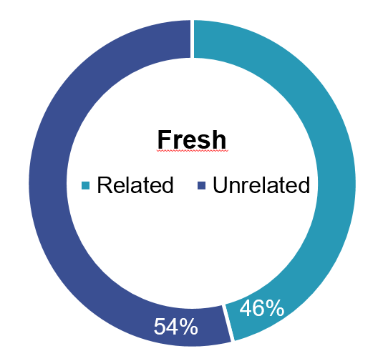
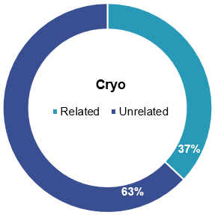
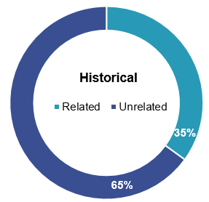
Donors and stem cell source
Fresh
HSC SOURCE | CATEGORY | Fresh N=68 | Cryo N=106
PBSC | N (% of all) | 57 (84%) | 93 (88%)
BM harvest | N (adult/paediatric) | 11 (0/11) | 13 (2/11)

Slide 28
Time to cryopreservation and transplantation
Factor | Category | N | Fresh N=68 | N | Cryopreserved N=106
Time from collection to cryopreservation (h and m) | Median | - | - | 52 | 44 h 58m
 | Range | - | - |  | 22h 40m – 56h 5m
Time from collection to transplant (days) | Median | 55 | 1 | 104 | 16 days
 | Range |  | 0 – 4 |  | 1 – 113

Slide 29
Outcomes I
 | CELL DATA | DATA | FRESH N=68 | CRYO N=106 | P VALUE | HISTORIC N=307 | P VALUE
FOLLOW-UP | Months | Median (range) | 12 (3 – 14) | 12 (1 – 16) | 0.58 | - | -
RECOVERY | Neutrophils > 0.5 x 10⁹/l (days) | Median (range) | 15 (8 – 41) | 15 (1 – 45) | 0.84 | 14 (1-71) | 0.12
 | Platelets > 20 x 10⁹/l (days) | Median (range) | 18 (3 – 53) | 19 (9 – 63) | 0.35 | 17 (5-85) | 0.001
GRAFT FAILURE | Primary | N | 2 (3%) | 2 (2%) | 0.50 | 6 (2%) | 0.53
 | Secondary | N | 1 (2%) | 1 (1%) | 0.67² | 2 (0.7%) | 0.57
ACUTE GvHD (GRADE II-IV) | At day 100 | % (95% CI) | 22% (14-34%) | 19% (12-28%) | - | - | -
PFS | At 12 months |  | 66% (52-77%) | 75% (64-83%) | 0.35 | - | -
STATUS AT FOLLOW-UP | Alive | N | 49 | 84 |  | 216
OS | At 12 months | Kaplan-Meier estimate (95% CI) | 66% (52% - 77%) | 76% (66% - 85%) | 0.26 | 77% (5-10%) | 0.16
¹ By Cox regression except where noted
² By Fisher’s exact test

Slide 30
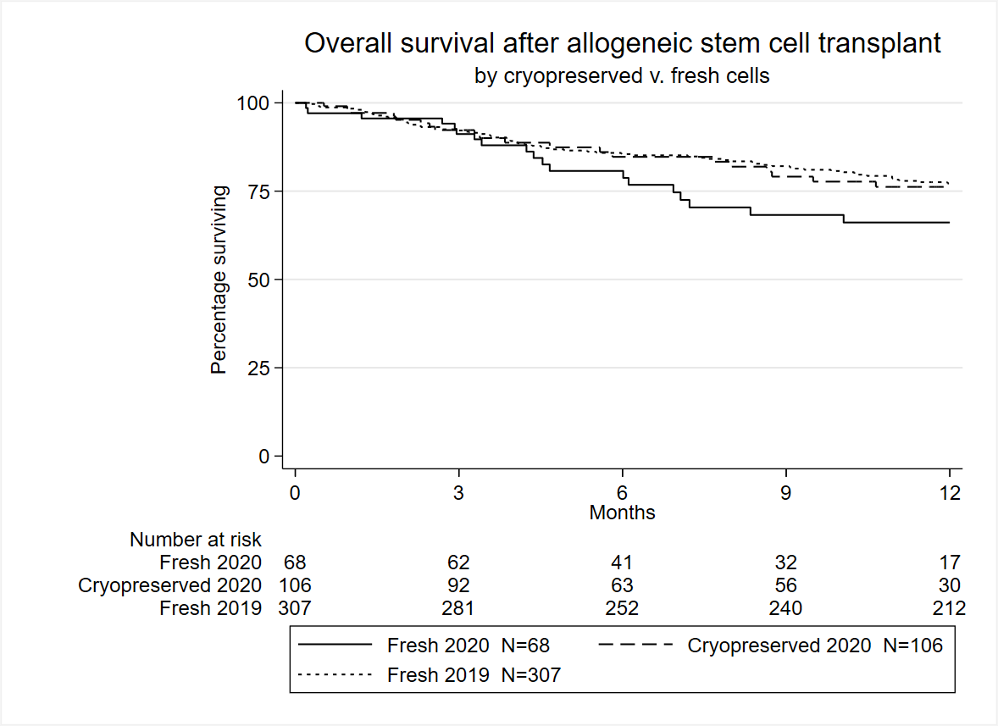
Outcomes II

Slide 31
Outcomes III
 | OUTCOME | Hazard ratio | P-value
Time from collection to cryopreservation | Neutrophil recovery | 1.004 | 0.737
 | Platelet recovery to 20 | 1.002 | 0.905
 | OS | 1.041 | 0.367
Time from collection to transplant | Neutrophil recovery | 0.998 | 0.704
 | Platelet recovery to 20 | 0.994 | 0.181
 | OS | 0.962 | 0.044
Notes:
Univariate analysis of continuous variables
Per hour
Per day
The l

Slide 32
Conclusions & next steps
Our 12 month follow-up study DID NOT DETECT a difference in major outcomes of patients who received fresh vs. cryopreserved allogeneic HSC graft
EXCEPT historic vs fresh/cryo median platelet engraftment time
Larger scale (>1000 patients) study with longer follow up (up to 24 months) data is under way
- Sub-group analysis might be useful for:
BM failure syndromes
MF
PTCy

Slide 33
Cryopreservation
Overall appears safe for patients - except
SAA
? myelofibrosis
? Post-Tx cyclophosphamide
Caution if >48 hours from collection to cryo
More data needed including immune reconstitution
But………………………

Slide 34
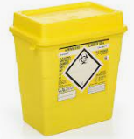
Impact on Donor – Product Cryopreservation
Many reports to WMDA of products not being infused
NMDP March 2020-June 2021: 222 products 0f 9294 donations unused¹
DKMS March – November 2020 : 79 of 2396 definitely not used²
178 “late”
5-8% products overall
17117899
1. Stefanski et al, Blood 2021, 2. Schmidt et al, AmJH 2021
Notes:
1 in 50 NMDP
1 in 30 DKMS

Slide 35
Reasons for Unused Products
Some due to patient issues:
patient deterioration in interval between donation and transplant
BBMR donor donated BM 15.6.20
Notification 16.6.20………….
delayed verification typing of patient (alert July 2020)
Donor harm - Unnecessary donor burden

Slide 36
Reasons for Unused Products
cell viability issues post-cryopreservation (alert May)
BBMR case:
WMDA reports – unused doses of 7.5 and 7.8 x 10^6 CD34/kg
Some TCs relying on Trypan blue
 | Lab | CD34/x 10^6/kg | P-T Viability | CFU/kg
Day 1 | CC | 2.3 | 97.5% | 1.2 x 10^5
 | TC | 0.73 viable | 33% | 1.1 x 10^4
Day 2 | CC | 3.9 | 97.4% | 1.3 x 10^5
 | TC | 2.55 viable | 70% | zero

Slide 37
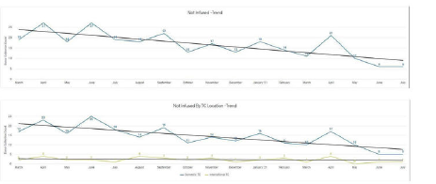
Rate of Cells Going Unused Falling¹
1. Stefanski et al, Blood 2021

Slide 38

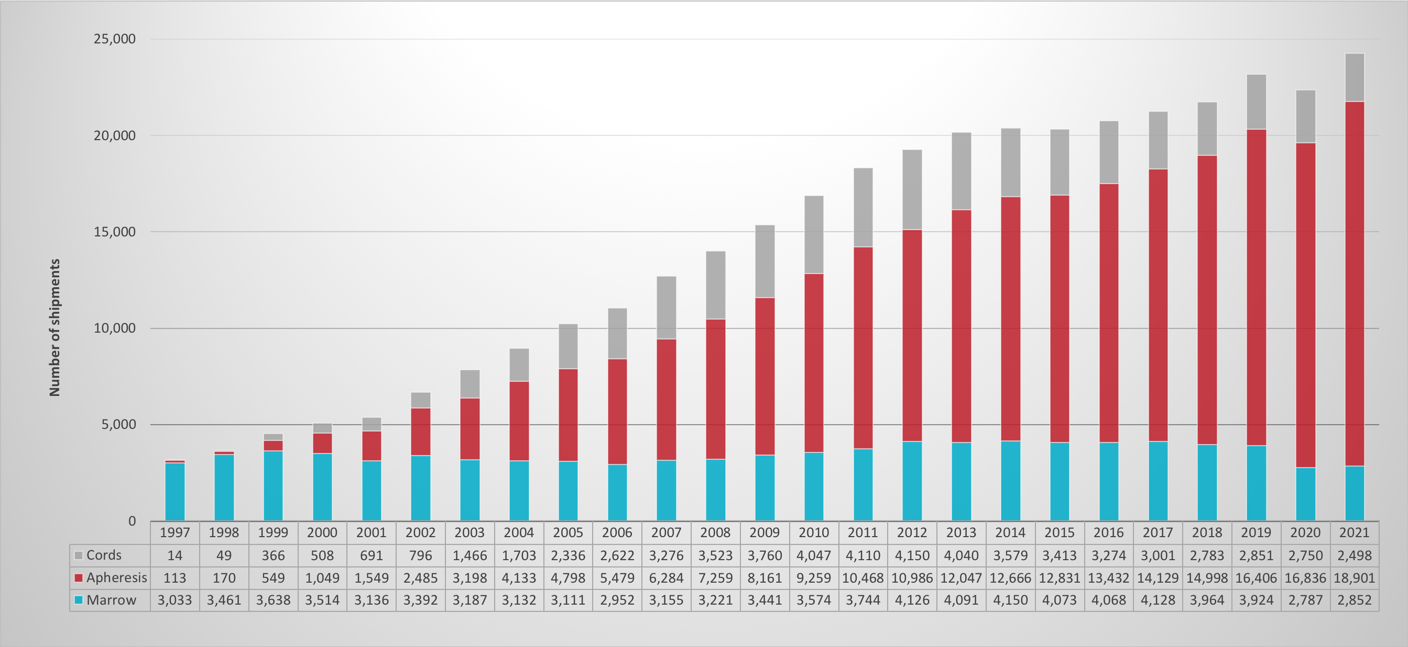
Unrelated HPC marrow, HPC apheresis and HPC cords
shipped worldwide 1997-2021

Slide 39
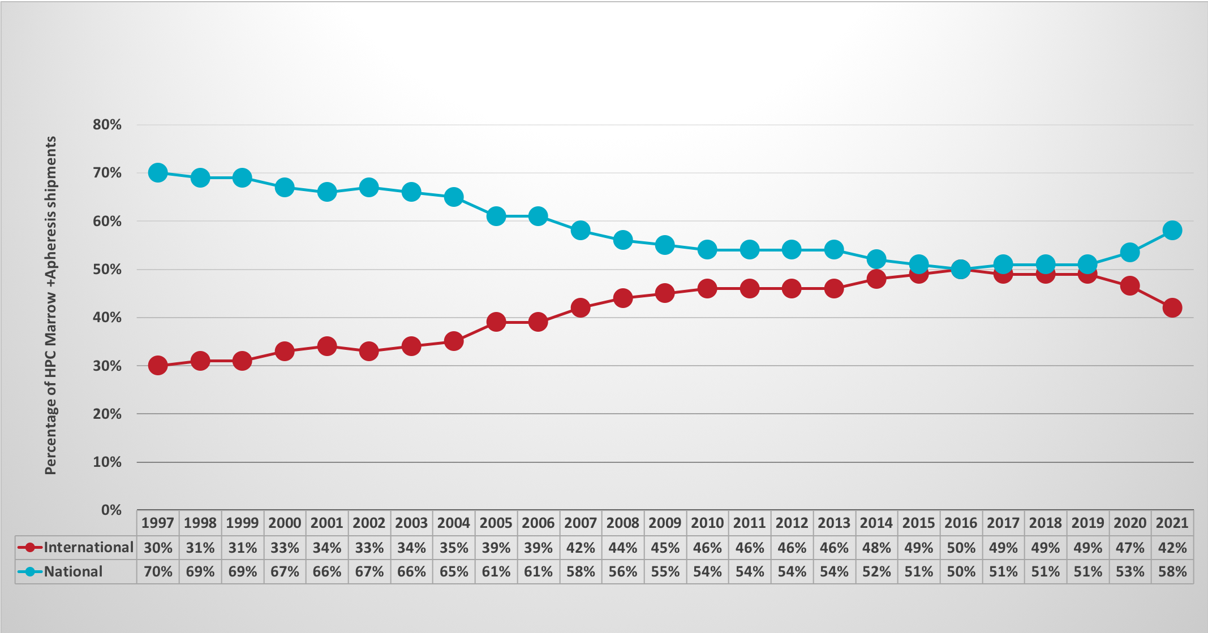
Percentage of HPC products (marrow/apheresis) provided worldwide for national and international patients 1997-2021

Slide 40
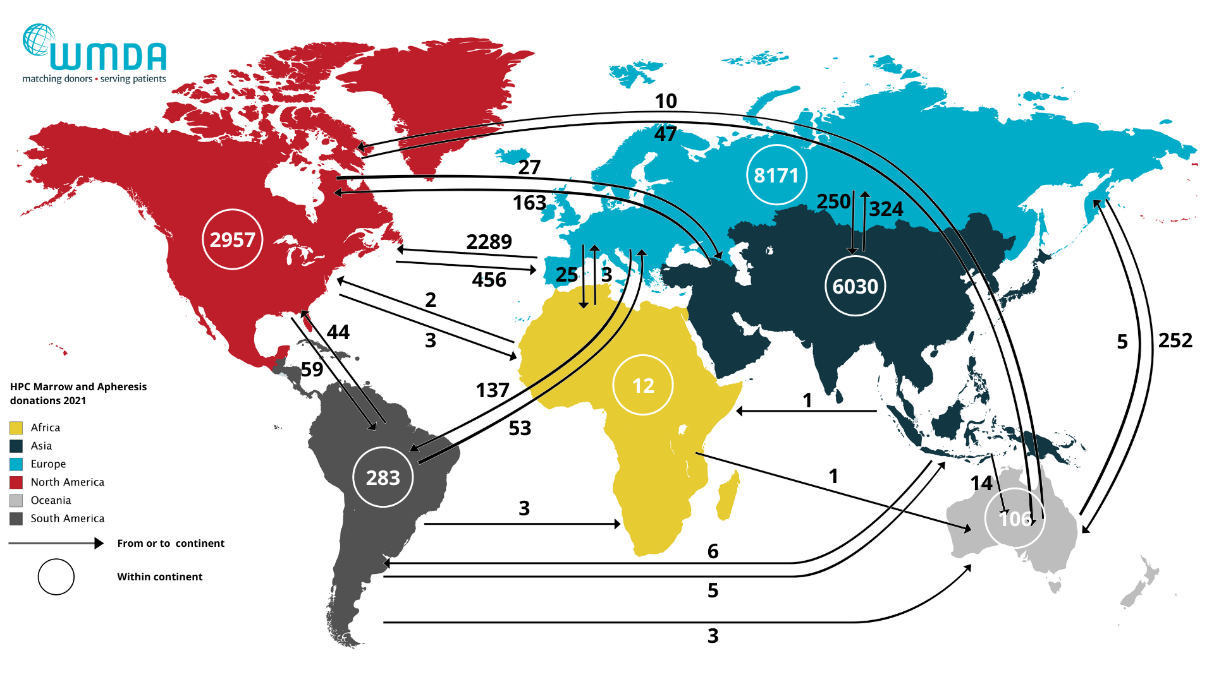
Global exchange of HPC products
(marrow/apheresis) 2021

Slide 41

Thank You
Our donors
BBMR
David Winstone Thilo Mengling
Kieran Herrity Eefke van Eerden
Ying Li Monique Joris (global trends report)
Ann O’Leary Julia Lee
Rob Danby Rachel Pearce
Angharad Price Marie Wilson
Ruta Maniusyte

