Slide 1

Developing in-house, point of care manufactured chimaeric antigen receptor (CAR)-T cells
Sandra Loaiza - Stem Cell User Group Meeting 33, 16th June 2022
The John Goldman Centre for Cellular Therapy (JGCCT)
Department of Haematology, Imperial College Healthcare NHS Trust

Slide 2
CAR-T cell immunotherapy
Established & effective treatment for relapsed/refractory B cell lineage blood cancers (ALL, lymphoma & multiple myeloma)
Currently 2 manufacturing models
High cost Low cost
Complex logistics Flexible low throughput
Lengthy process (>4 weeks) Academic / investigator led novel CAR-T cell therapies
Established commercial centralised model
Emerging point-of-care (POC) model

Slide 3
What is involved in developing and implementing POC model for CAR T-cell therapy?
Process development
JGCCT laboratory
Regulatory Portfolio
Protocol
Ethics approval
Joint Research Safety Committee approval
Investigational Medicinal Product dossier(IMPD)
Investigator’s Brochure (IB)
Multi-disciplinary team
Apheresis
Manufacturing laboratory
Pharmacy
Clinical services (Haematology, Neurology & ITU)
Regulatory Agencies
Joint Accreditation Committee ISCT-Europe & EBMT (JACIE)
Medicines & Healthcare Products Regulatory Agency (MHRA)

Slide 4
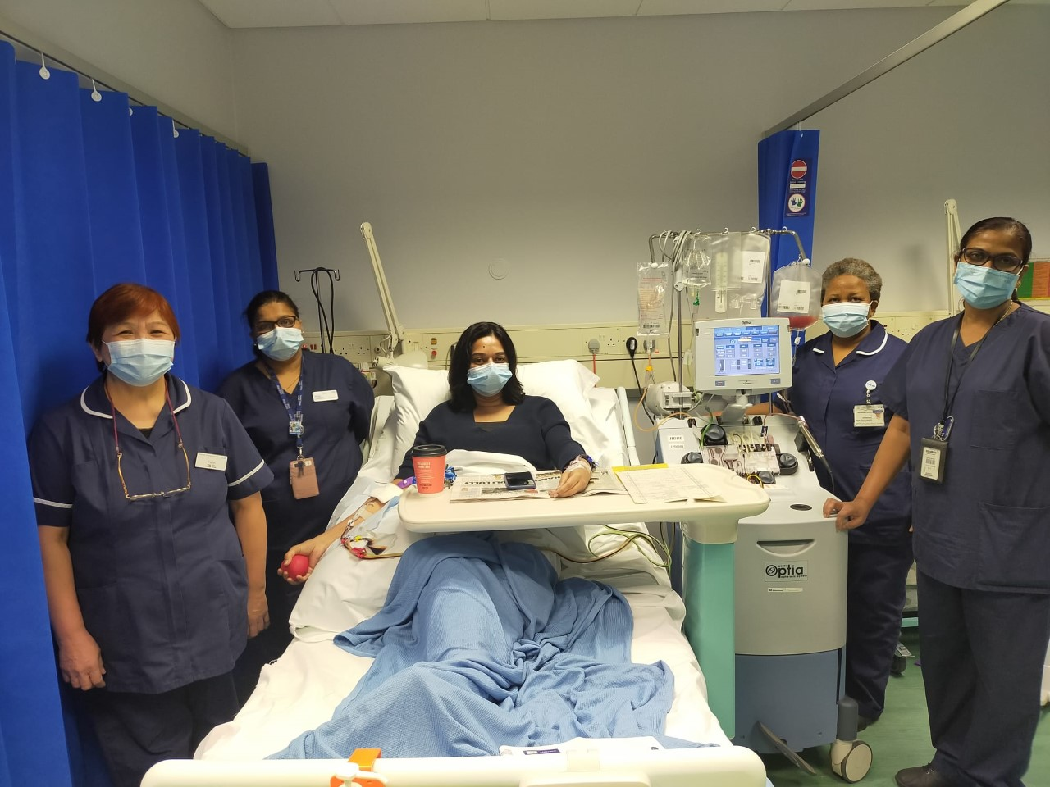
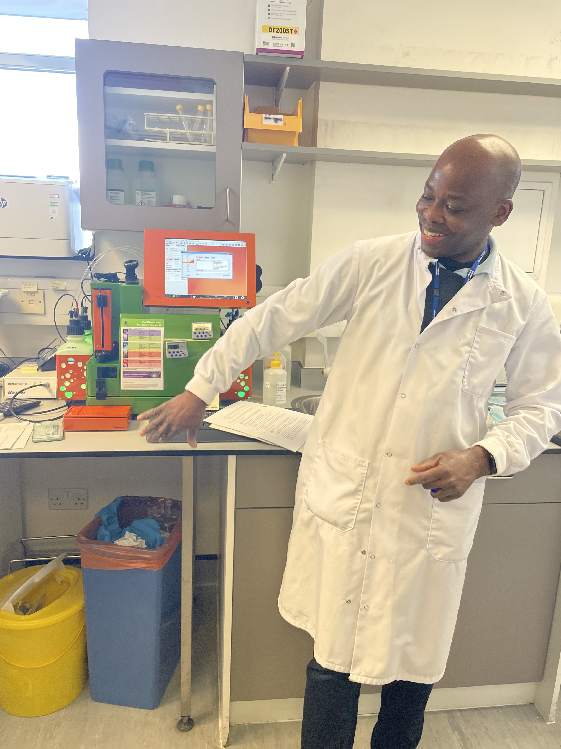
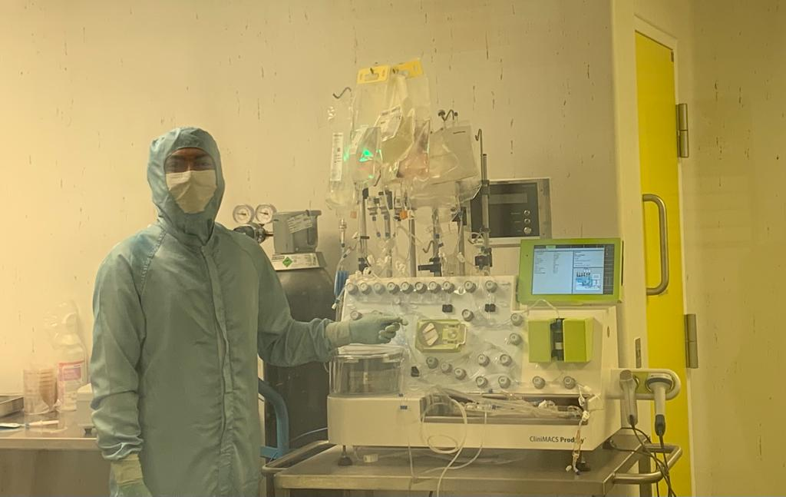
1st donor for in-house CAR-T manufacture with the apheresis team
Flow cytometry performed on the MACSQuant® Analyzer
Automated CAR-T manufacture using the CliniMACS Prodigy Instrument

Slide 5
CAR-T cell manufacturing using Miltenyi Biotec automated Clinimacs Prodigy system in the JGCCT laboratory
d0
d12
Notes:
The Lentiviral Vector aCD19 CAR SF has been developed for the ex vivo transduction of T cells in order to confer expression of an (anti-) CD19 chimeric antigen receptor (CAR)

Slide 6
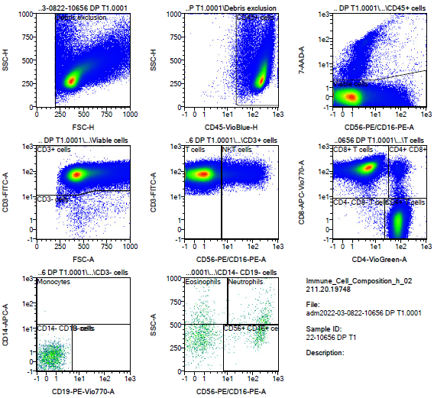
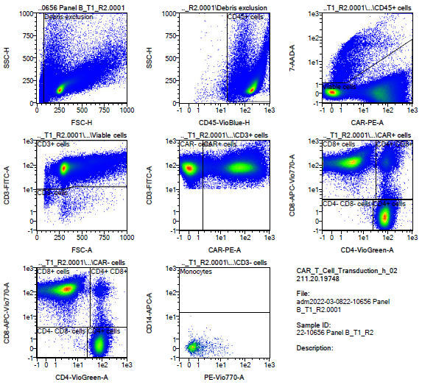
Validation Run 1 data
Panel A – cell count determination
Panel B – % CAR

Slide 7
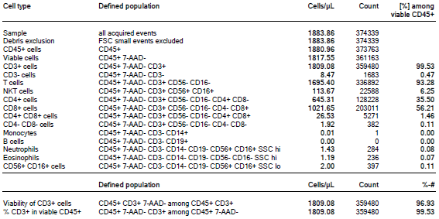
Validation Run 1 data
Panel A – immune cell composition

Slide 8
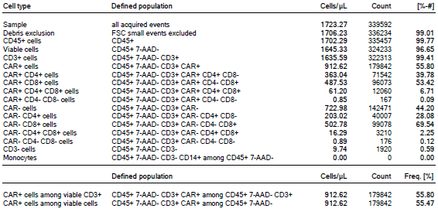
Validation Run 1 data
Panel B – transduction efficiency

Slide 9
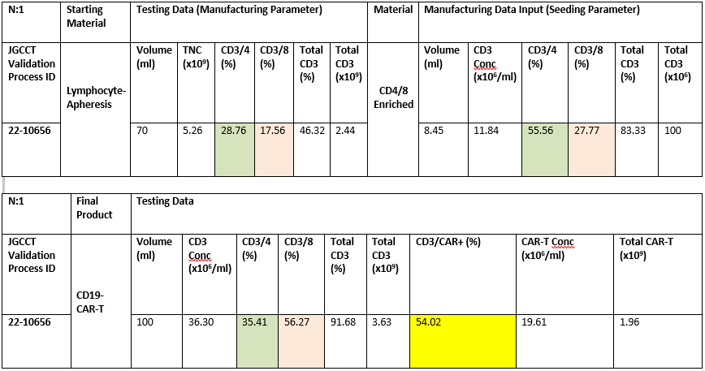
Validation Run 1 data Summary
*samples run in duplicate (above average of n=2)

Slide 10
Current plan at ICHNT
Process validation using healthy donors (n=3)
Apply for a variation for marketing authorisation by the MHRA
Proof of efficacy in a Phase I study in CD19+ B-cell lymphomas (n=6)
Future
Expand programme to support clinical research in autoimmune conditions such as SLE and other haematological malignancies

Slide 11
Establishing CAR-T cell programme at ICHNT
CAR-T cell therapy falls under the ATMP framework, presenting unique challenges to all stakeholders
Joint Accreditation Committee ISCT-Europe & EBMT (JACIE) official accreditation body in haematopoietic stem cell transplantation (HSCT) and cellular therapy
Accreditation of a centre by a competent authority is understood as verification that the required standards are followed and necessary qualifications, processes and resources are present
ICHNT recently underwent JACIE inspection for immune effector cell (IEC) therapy

Slide 12
Establishing CAR-T cell programme at ICHNT
CAR-T is a complex service to deliver
Sharing of information and lessons learned by wave 1 and 2 hospitals
National CAR-T cell MDT, support from Royal Marsden
On-boarding sessions with commercial CAR-T cell companies
Pan UK Pharmacy Working Group for ATMPs

Slide 13
Establishing CAR-T cell programme at ICHNT
Cytokine release syndrome
most common toxicity post CAR-T cell therapy, potentially life-threatening, due to immune activation → release of inflammatory cytokines
Immune cell-associated neurotoxicity syndrome (ICANS)
in 20-60%, severe in 10-30%
Intensive care unit and neurology support essential
Robust SOPs and clinical guidelines/pathways
Staff training, competency assessments

Slide 14
Summary
Phase I study in CD19+ B-cell lymphomas currently in set up with a successful validation run
Clinical preparedness, guidelines/SOPs, staff training and JACIE accreditation underway
Academia will continue to play a significant role in development and
delivery of these new therapies
Expand programme to support clinical research in autoimmune conditions such as SLE and other haematological malignancies
Notes:
ICHNT only centre other than UCL making own CAR T-cells without a spin out company
Instead of personalising which is hugely expensive with respect to GMP give off the shelf CAR-iNKT products (work current underway)

Slide 15
Acknowledgement
JGCCT Laboratory
Edward Aina
Shab Uddin
Sandra Loaiza
Emma Bray
Kaivalya Kulkarni
Robert Chisnall
Simi Fadipe
Kishmeet Kaur
Ruth Emhazion
Haematology Department
Anastasios Karadimitris
Jane Apperley
Lucy Cook
Renuka Palanicawandar
Eduardo Olavarria
Pharmacy staff
Apheresis Unit staff
Quality Team
Anna Bara (Imperial College)
Miltenyi Biotec Technical team

