Slide 1
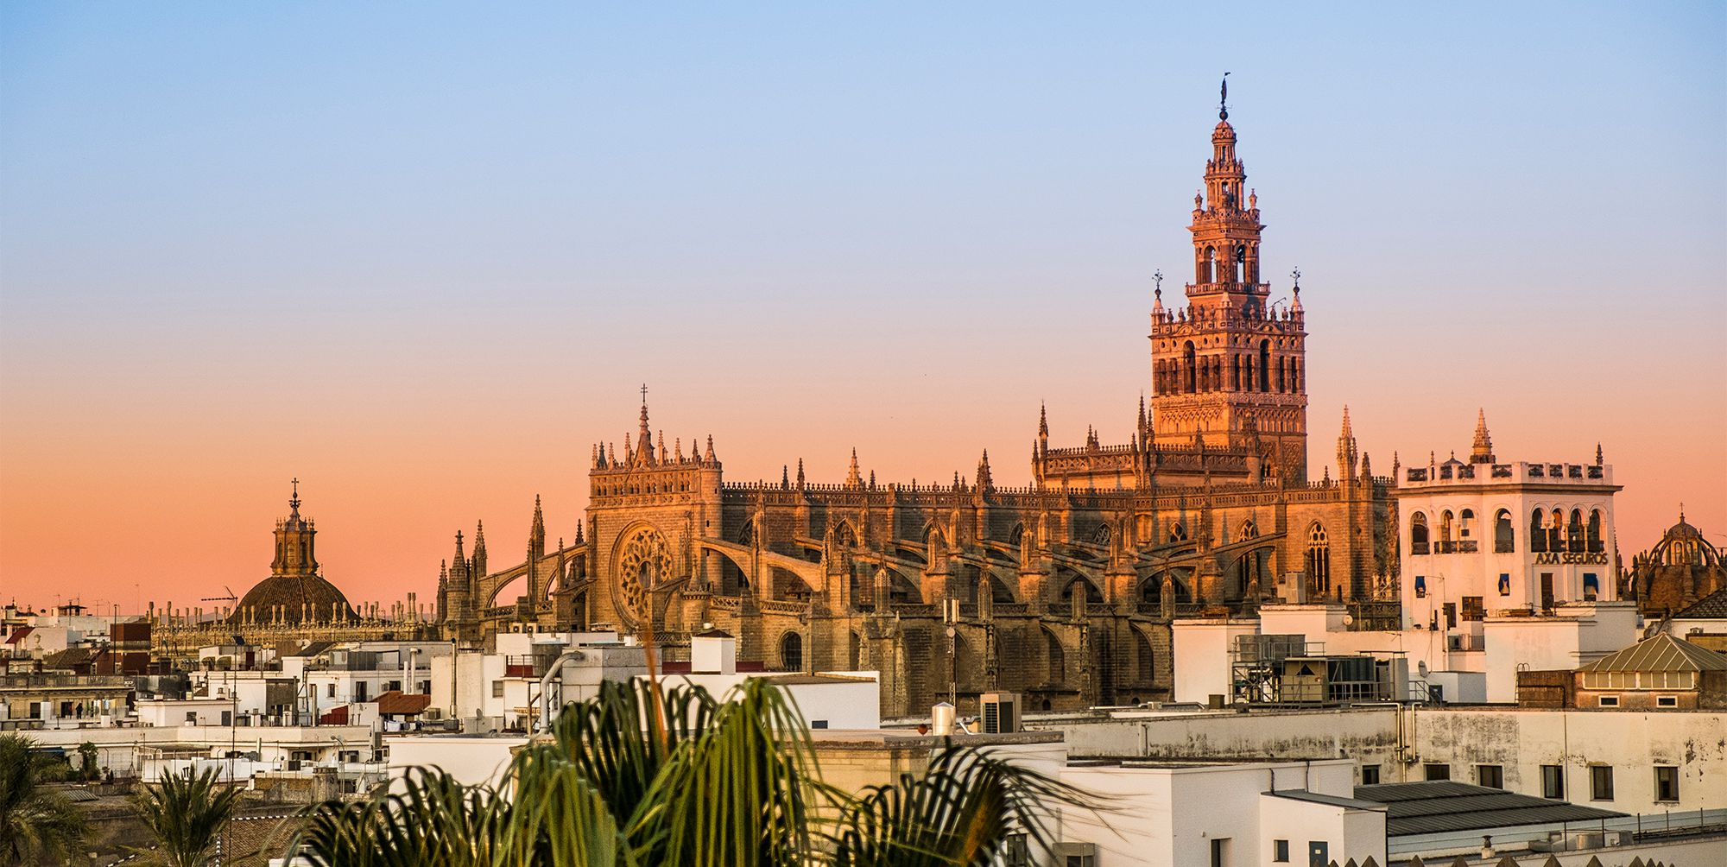
SLTB Scientific Meeting 2019
University of Seville, Spain
3-4th October 2019
2nd October, Cell Therapy Workshop in collaboration with SCUG
5th October, Optional Seville City Tour

